Slide 1
Neurophonetics
Vijay Solanki
Semester 2 – Week 7
v.solanki.1@research.gla.ac.uk

Slide 2
What is Neurophonetics?
“Neurophonetics deals with neurogenic impairments of the motor act of speaking and of the perceptual processes of spoken language understanding, with the aim of unravelling the neural organization of speech motor control and speech perception” (Ziegler 2008: 491)
“Neurophonetics aims at the elucidation of the brain mechanisms underlying speech communication in our species” (Hertrich & Ackermann 2013)
“To the extent that phonetics is a subdiscipline of linguistics, neurophonetics can be viewed as a subdiscipline of neurolinguistics” (Ziegler 2008)

Slide 3
Lecture Outline
Anatomy & Physiology of the Brain
The WLG Model
Measurement Tools
Modern Advances
Classic Neuroimaging Studies
Anatomical Contributions
The Integration Problem
Conclusion
Notes:
Learning Outcomes
Acquire a basic understanding of the anatomy and Physiology of the human brain.
Understand the beginnings of neurolinguistics (ie. the WLG model) and how the field has progressed.
Gain a rough understanding of modern neuroimaging techniques and their advantages/drawbacks.
Develop a basic understanding of modern thinking behind neurolinguistics/phonetics
Understand what some of the classic neurolinguistic imaging studies can tell us about language processing
Develop knowledge of what additional anatomical structures in the brain contribute to language processing
Gain a very basic insight into the direction that the field is heading
By the end, it should be clear that the brain runs multiple functions simultaneously in order to interpret speech.

Slide 4
Warning Slide
There will be some bloody(ish) images

Slide 5
Anatomy & Physiology of the Brain

Slide 6
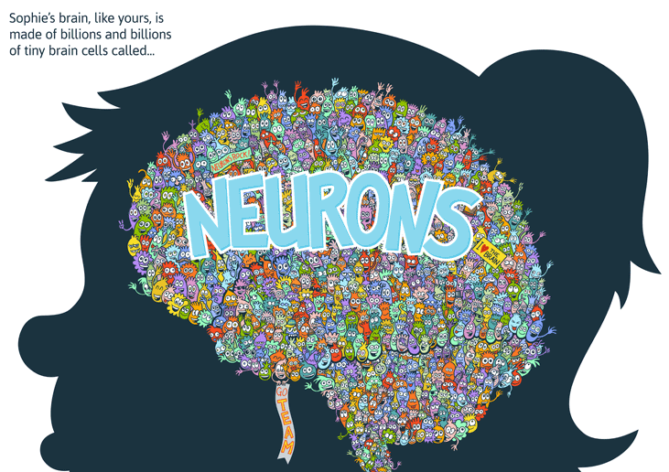
Illustration for Ned the Neuron, published by Kizoom in 2012.
Notes:
This is generally a good way to think about the brain, although it does need a little refinement…

Slide 7
Anatomy and Physiology
The brain is made up of NEURONS and GLIAL CELLS (but glial cells are not discussed here)
NEURONS are arranged into layers which allow for the efficient transfer of information, carried as electrical impulses
NEURONAL LAYERS in different areas are arranged to maximise processing efficiency for the functions that they are required to perform and provide the basis for the larger structures of the brain
Notes:
Essentially, you need to understand that the brain operates at many different levels in order to process incoming information and to integrate it with information already stored in memory.

Slide 8
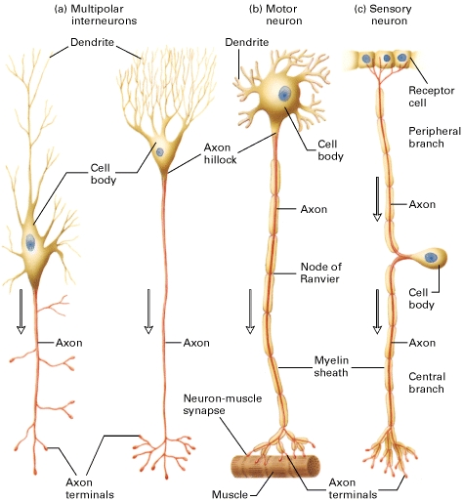

Neurons
Neurons transmit information to other neurons or muscles (via the brain stem)
FIRING: electrical ACTION POTENTIAL travels down AXON to SYNAPSE (junction)
A NEUROTRANSMITTER is released which either EXCITES or INHIBITS the post-synaptic cell
MYELIN encases important connections, both to protect vital information transfer routes and to speed up transmission of the action potential
Web Source [1]
Notes:
Arrows indicate the direction of conduction of action potentials in axons (red). (a) Multipolar interneurons. Each has profusely branched dendrites, which receive signals at synapses with several hundred other neurons, and a single long axon that branches laterally and at its terminus. (b) A motor neuron that innervates a muscle cell. Typically, motor neurons have a single long axon extending from the cell body to the effector cell. In mammalian motor neurons an insulating sheath of myelin usually covers all parts of the axon except at the nodes of Ranvier and the axon terminals. (c) A sensory neuron in which the axon branches just after it leaves the cell body. The peripheral branch carries the nerve impulse from the receptor cell to the cell body, which is located in the dorsal root ganglion near the spinal cord; the central branch carries the impulse from the cell body to the spinal cord or brain. Both branches are structurally and functionally axons, except at their terminal portions, even though the peripheral branch conducts impulses toward, rather than away from, the cell body.

Slide 9
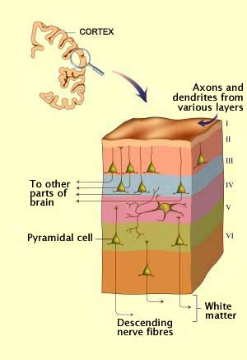
Neuronal Layers
Neurons are arranged into layers specific to the functions that they are required to perform
Neurons that perform similar functions are LOCALISED to a particular region of the brain
Web Source [2]
Notes:
All neurons are not created equal.
The information that any given neuron or network of neurons is required to processes is specific to its location in the brain and is relative to those neurons that it is connected to.

Slide 10
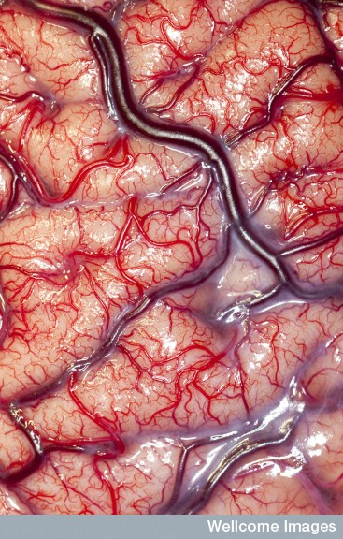
Photograph by Robert Ludlow. Wellcome Trust Image Awards winner 2012.
Gyrus
(bumps)
Sulcus
(dips)
Notes:
This image is here to highlight the fact that when we talk about the “cortex”, we are only considering the outer layer of the brain and not the deep brain structures.
Arteries (small red)
Veins (big purple)
“Grey matter” and “white matter”: but pink
Intracranial recording for epilepsy. Surface of human brain in situ.
Gyrus/Gyri = the outward folds of the cortex
Sulcus/Sulci = the inward folds of the cortex

Slide 11
http://www.g2conline.org/
Notes:
Sections to take note of and explain include:
- Each of the major lobes and what their functions seem to be
- Frontal = The frontal lobes are part of the cerebral cortex and are the largest of the brain's structures. They are the main site of so–called 'higher' cognitive functions. The frontal lobes contain a number of important substructures, including the prefrontal cortex, orbitofrontal cortex, motor and premotor cortices, and Broca's area. These substructures are involved in attention and thought, voluntary movement, decision–making, and language.
- Parietal = The parietal cortex plays an important role in integrating information from different senses to build a coherent picture of the world. It integrates information from the ventral visual pathways (which process what things are) and dorsal visual pathways (which process where things are). This allows us to coordinate our movements in response to the objects in our environment. It contains a number of distinct reference maps of the body, near space, and distant space, which are constantly updated as we move and interact with the world. The parietal cortex processes attentional awareness of the environment, is involved in manipulating objects, and representing numbers.
- Temporal = The temporal lobes contain a large number of substructures, whose functions include perception, face recognition, object recognition, memory acquisition, understanding language, and emotional reactions. Damage to the temporal lobes can result in intriguing neurological deficits called agnosias, which refer to the inability to recognize specific categories (body parts, colors, faces, music, smells).
- Occipital = The occipital cortex is the primary visual area of the brain. It receives projections from the retina (via the thalamus) from where different groups of neurons separately encode different visual information such as color, orientation, and motion. Pathways from the occipital lobes reach the temporal and parietal lobes and are eventually processed consciously. Two important pathways of information originating in the occipital lobes are the dorsal and ventral streams. The dorsal stream projects to the parietal lobes and processes where objects are located. The ventral stream projects to structures in the temporal lobes and processes what objects are.
- Corpus Callosum
- Motor Cortex
- Somatosensory Cortex
- Primary Auditory Cortex
- Cerebellum
- Basal ganglia, thalamus, limbic system, hippocampus

Slide 12
Cerebrum, cerebral cortex
Cerebrum = 2 hemispheres
Each hemisphere is divided into 4 lobes
Frontal
Parietal
Temporal
Occipital
Cerebral cortex = surface of cerebrum
Cortex can be roughly divided into areas of functions
e.g. language, personality, vision, audition, motor and sensory functions
Notes:
Brief overview of what was said.

Slide 13
Left and right hemispheres
Equal size/proportion, but different white/grey matter structures
Different networks of connectivity
Some functions are the same
MOVEMENT
SENSATION
However, some functions are different across the two hemispheres…
Planning & execution cross sides
Notes:
So the left side of your brain controls the right side of your body, and the right side of your brain the left side
Likewise information from your right eye goes to the left side of your brain, etc.

Slide 14
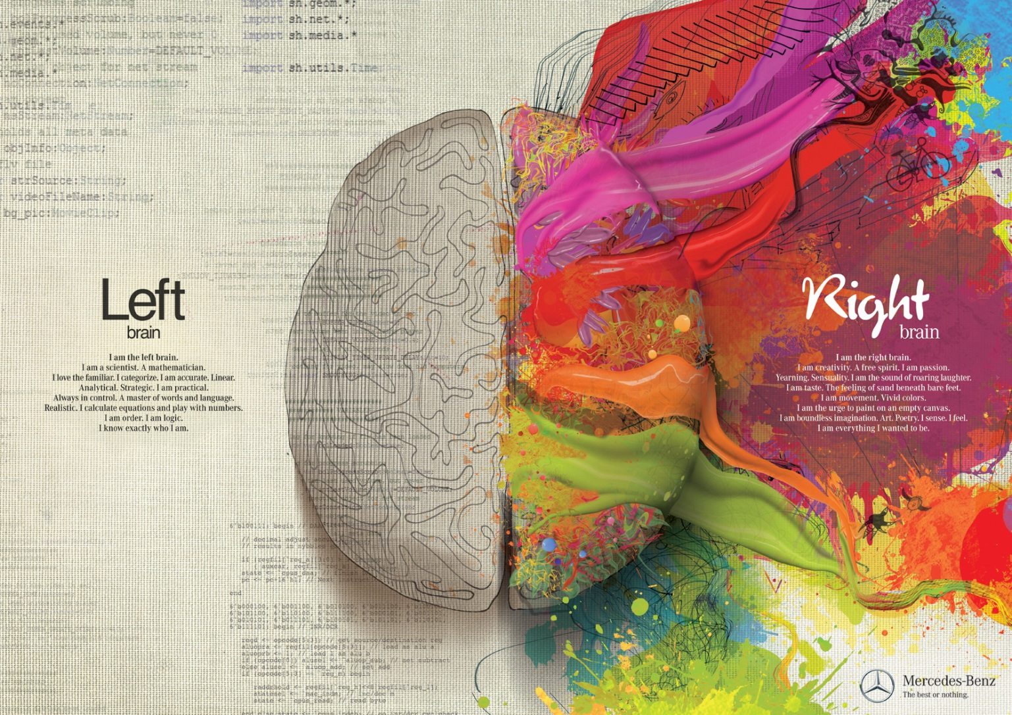
Left Brain – Right Brain
WRONG
Nielsen, et al. (2013)
Notes:
You are not “Right-Brained” of “Left Brained” the hemispheres just have specific localised processing strengths.
Both hemispheres are required to process information efficiently and effectively.

Slide 15
Hemispheric functions
Each hemisphere has specific processing strengths, eg:
Left Hemisphere
Important for language processing, mathematical functioning
(Hervé, et al. 2013, Jolles et al. 2015)
Right Hemisphere
Important for processing visual and spatial information
(Hervé, et al. 2013)
Notes:
Having said this, both hemispheres are required in order to correctly process speech.

Slide 16
Within the cerebrum
Cortex (cerebrum surface):
Grey matter (nerve cell bodies)
Some white matter
Subcortical areas:
Grey matter
White matter fibres (eg.):
Corpus Callosum (connects right and left hemispheres)
Arcuate Fasciculus (connects motor and sensory cortices)
Arcuate Fasciculus
Notes:
We will be coming back to discuss the function of the Arcuate Fasciculus in the next section

Slide 17
The WLG Model

Slide 18
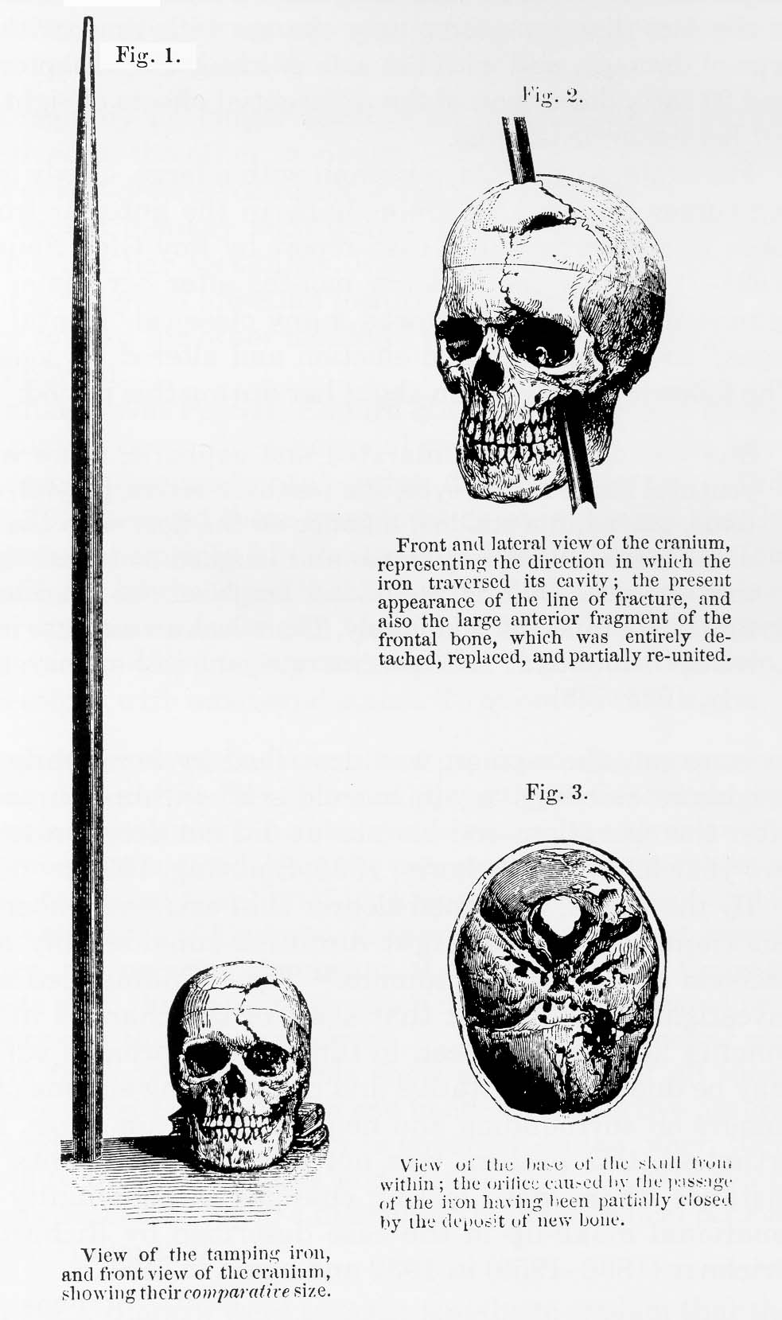
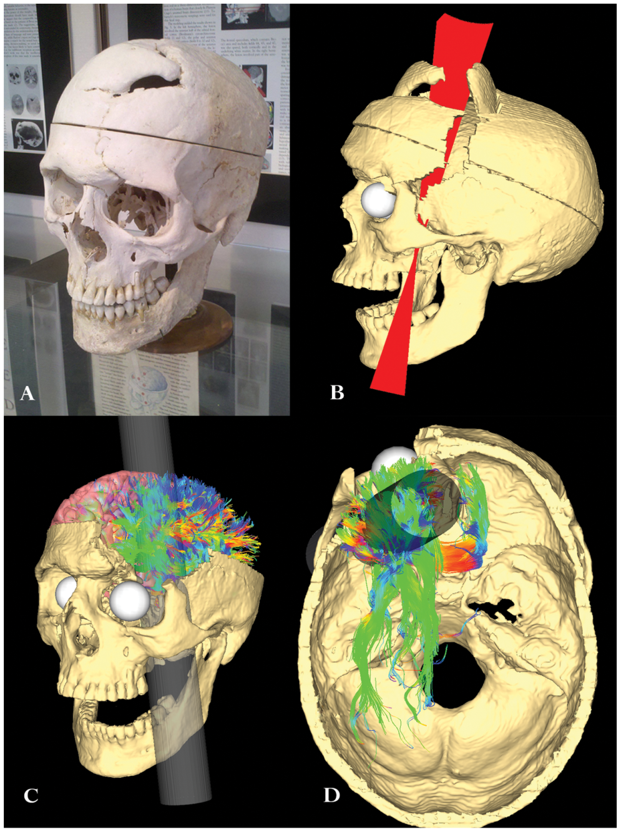
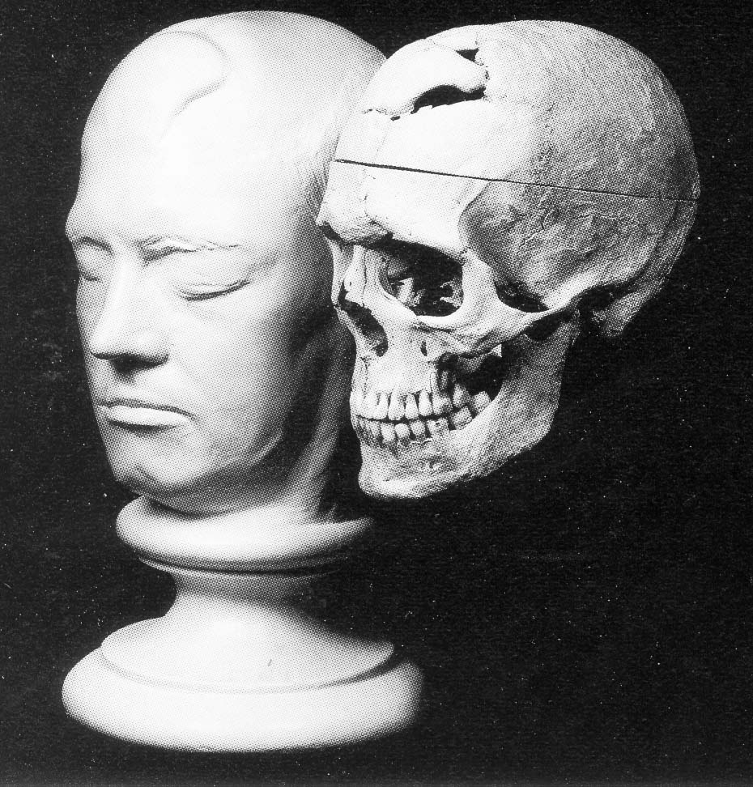
Phineas Gage
(1823-1861, accident in 1848)
Van Horn, et al. (2012)
Notes:
Gage was a railroad construction worker who suffered an unusual kind of traumatic brain injury which inflicted severe damage to parts of his frontal brain during a work accident.
His case was so extraordinary that he is still studied to this day.

Slide 19
Phineas Gage (1848)
Trauma to frontal lobe
One of first cases to highlight role of frontal lobe in:
Personality
Emotional regulation
Decision making / Problem solving
What does this suggest?
Specific brain functions are grouped in specialised regions
We say that brain function is LOCALISED
Notes:
Gage reportedly had significant changes in personality and temperament, which provided some of the first evidence that specific parts of the brain, particularly the frontal lobes, might be involved in specific psychological processes dealing with emotion, personality and problem solving.
Gage's case is cited as among the first evidence suggesting that damage to the frontal lobes could alter aspects of personality and affect socially appropriate interaction. Before this time the frontal lobes were largely thought to have little role in behaviour.
This is essentially how we assessed the function of the various areas of the brain. We had to look for patients with “lesions” in the brain.
These are known as “lesion studies”.

Slide 20
Brain Pathology and Language
Aphasia: Loss or impairment of the ability to produce or comprehend language, due to brain damage
Various types:
Global
Broca’s/motor
Wernicke’s/jargon/anomic
Notes:
Many types of APHASIA – here are some.

Slide 21
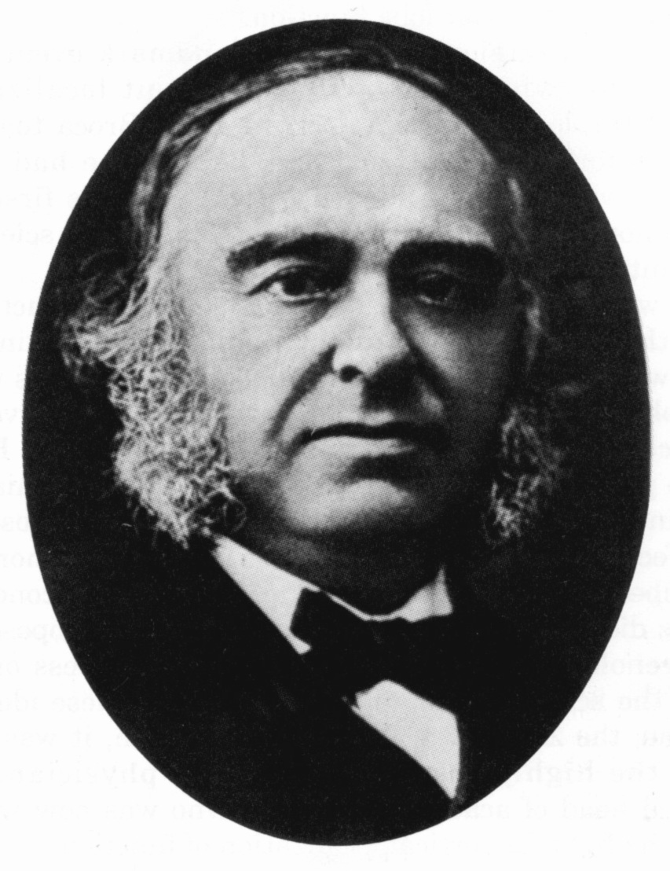
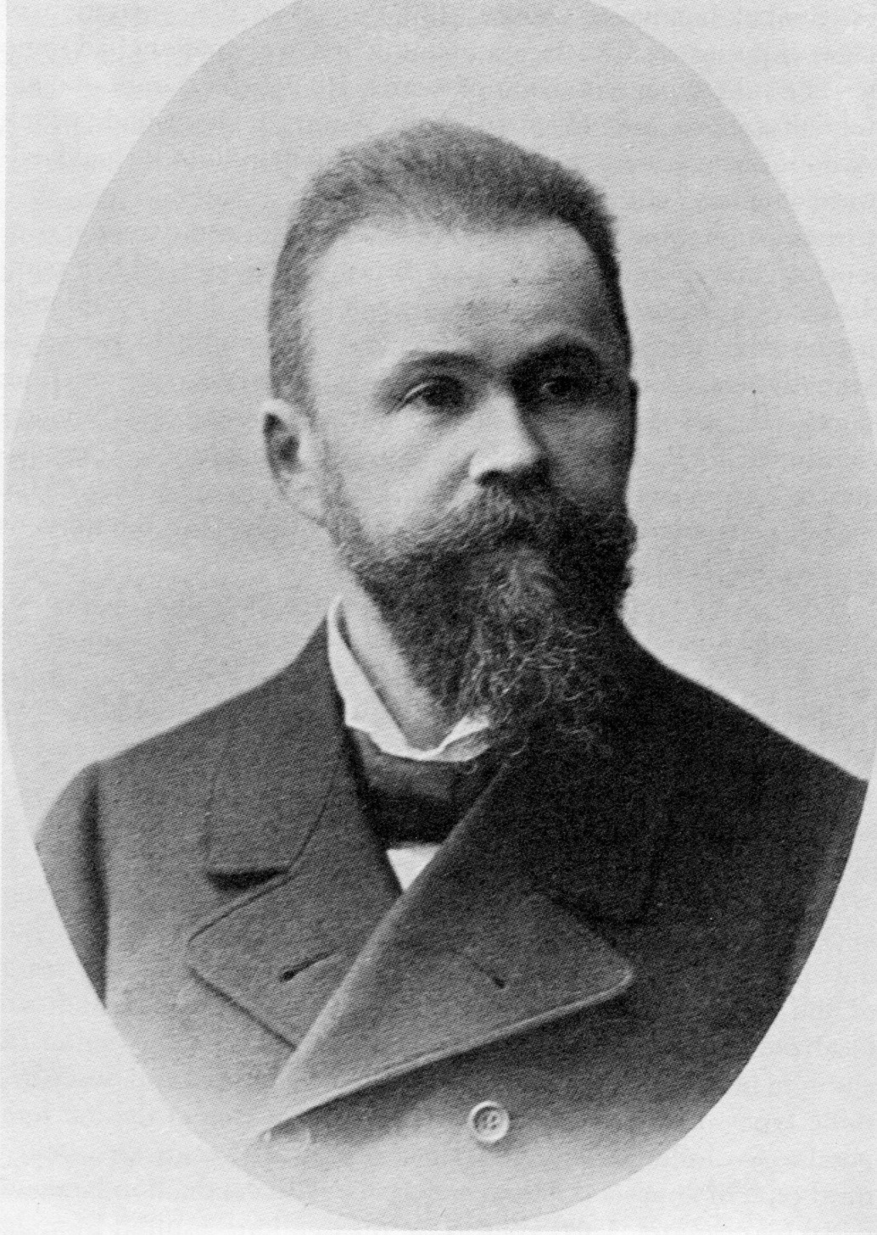
Broca & Wernicke
Paul Broca (1824-1880)
Broca’s patient, ‘Tan’ – 1861
Problem with production (only one syllable ‘tan’)
Large cyst in the left hemisphere (“mushy and deformed”)
Karl Wernicke (1848-1905)
Wernicke’s patient – 1874
Patient who could speak but couldn’t comprehend language
Lesion at the crossroads of 2 lobes of the brain

Slide 22
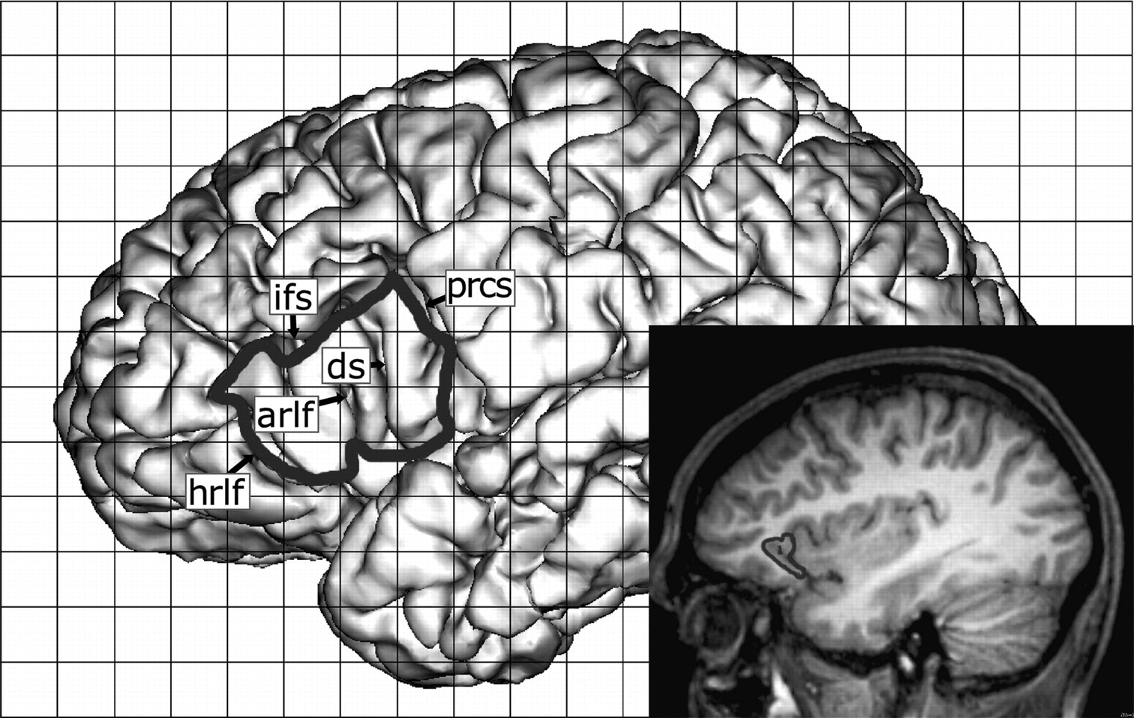
Broca’s Area
Where?
Frontal lobe - Inferior frontal gyrus
Pars opercularis
Pars triangularis
Anwander, et al. (2007)

Slide 23
Broca’s Aphasia
Function
Motor language area
Expression
Aphasia
Motor / non-fluent aphasia
Good comprehension, no/impaired speech
E.G. ‘boy go store’ vs ‘The boy has gone to the store’
Slow, laboured, ungrammatical speech
“yes…ah…Monday…ah…dad and…and…ah…hospital….and ah….Wednesday….Wednesday”
Notes:
To understand the symptoms, recall that Broca's area controls expression, whereas Wernicke's area is responsible for comprehension.

Slide 24
http://youtu.be/f2IiMEbMnPM

Slide 25
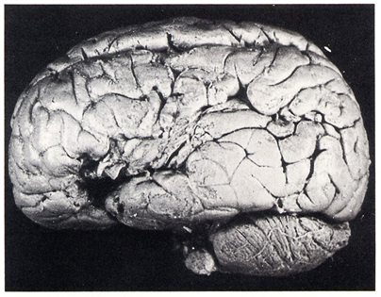
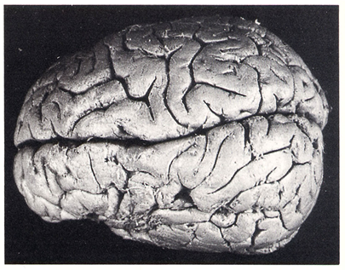
Broca’s Area
Photograph of the brain of Paul Broca’s patient called “Tan”
Notes:
The areas of the brain that had atrophied in Tan’s brain are highlighted.

Slide 26
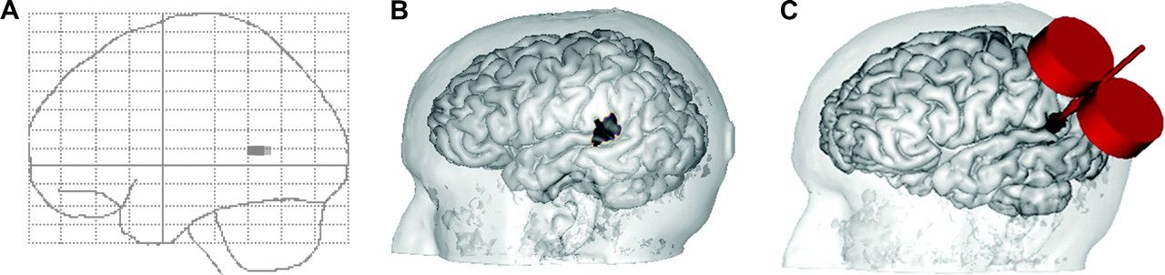
Wernicke’s Area
Where?
Temporal/Parietal lobe
Supramaringal gyrus
Angular gyrus
Andoh, et al. (2008)

Slide 27
Wernicke’s Area
Function
Sensory language area
Comprehension
Aphasia
Fluent / Receptive (cortical sensory) aphasia
defect in comprehension, good spontaneous speech
Anomic aphasia - word finding difficulty
Jargon aphasia - fluent, but unintelligible jargon

Slide 28
http://youtu.be/aVhYN7NTIKU
Notes:
In WERNICKE’S aphasia - Patients can utter strings of speech which are grammatically ok but make NO SENSE.
e.g word finding difficulties. E.g. table [chair]
Wernicke’s area was generally thought to be the site for language comprehension but it also has a role in looking up word and funnelling them to other areas.

Slide 29
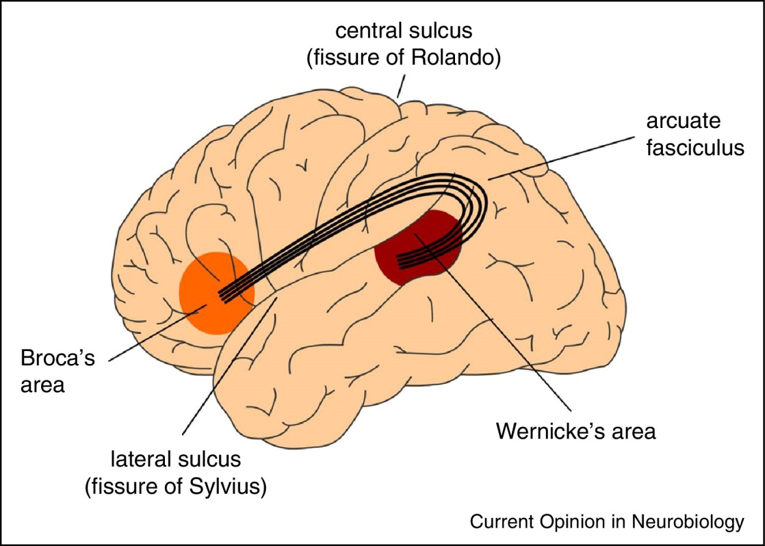
The WLG Model
Broca’s and Wernicke’s areas are connected via the ARCUATE FASCICULUS
This view was dominant for more than a century and still carries weight today
It is known as the Wernicke-Lichtheim-Gerschwind Model (WLG model), named after those that helped to develop it
Hagoort (2014)
Notes:
A link between the production and comprehension areas is necessary to produce a percept of language/speech, thus the WLG model was posited.
Recall that the Arcuate Fasciculus is a bundle of WHITE MATTER which acts as an information transfer highway.

Slide 30
Summary
Broca’s area
Inferior frontal gyrus (frontal lobe)
Good comprehension but impaired speech
Seat of language production(?)
Wernicke’s area
Supramaringal/angular gyrus (temporal/parietal lobe)
Good production but defect in comprehension
Seat of language comprehension(?)
Both localised to left hemisphere
They operate together as part of a larger network
Notes:
This class of theories are known as the LOCALIST view
They view functions in the brain as connected but fundamentally separate with only one function per area.

Slide 31
Measurement Tools
Notes:
In order to understand a lot of the information in the remainder of the lecture, it is important to have a basic understanding of the techniques that are used to evaluate the structure and function of brain regions.

Slide 32
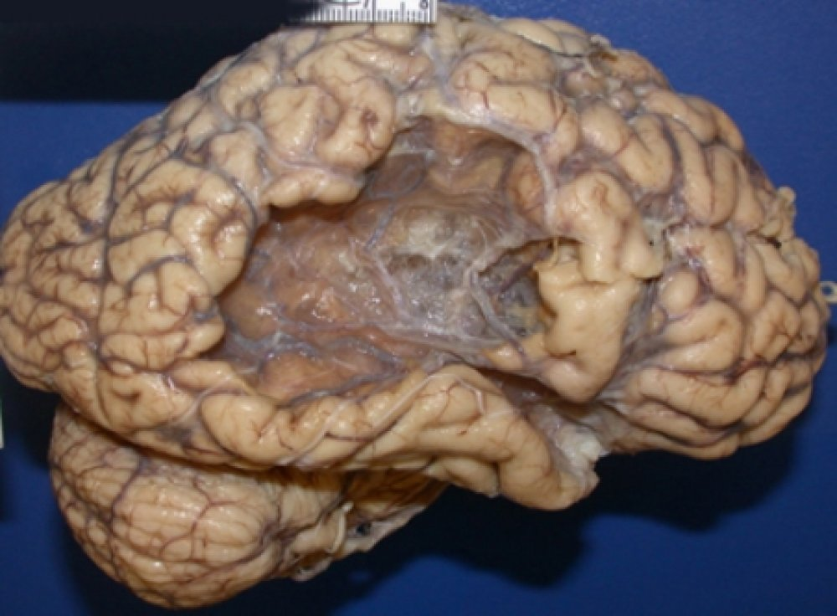
We’ve come a long way…
Traditional methods for interpreting brain function mainly involved LESION STUDIES
Not always possible to assess brain function IN-VIVO
Cannot be restricted to REGIONS OF INTEREST
Modern methods are somewhat more elegant…
Web Source [3]

Slide 33
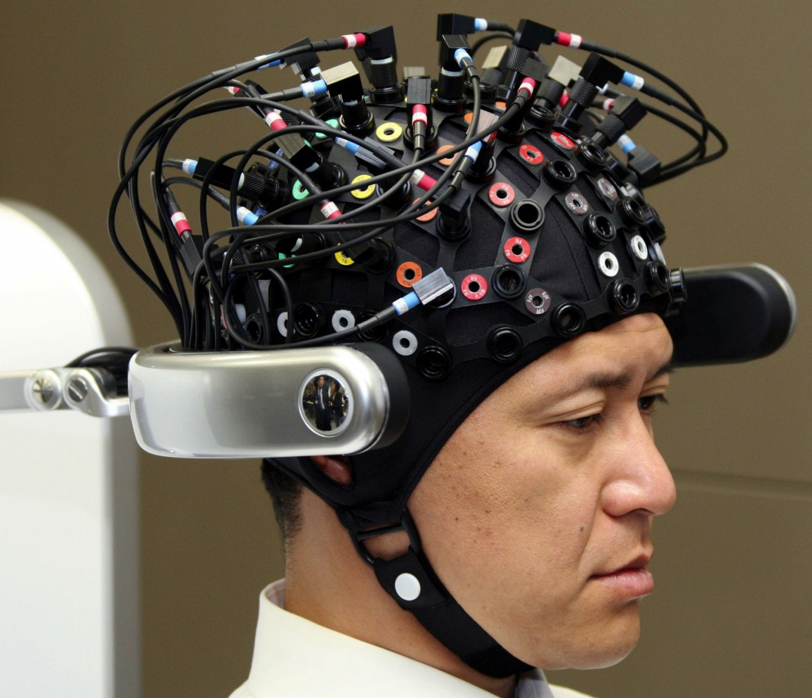
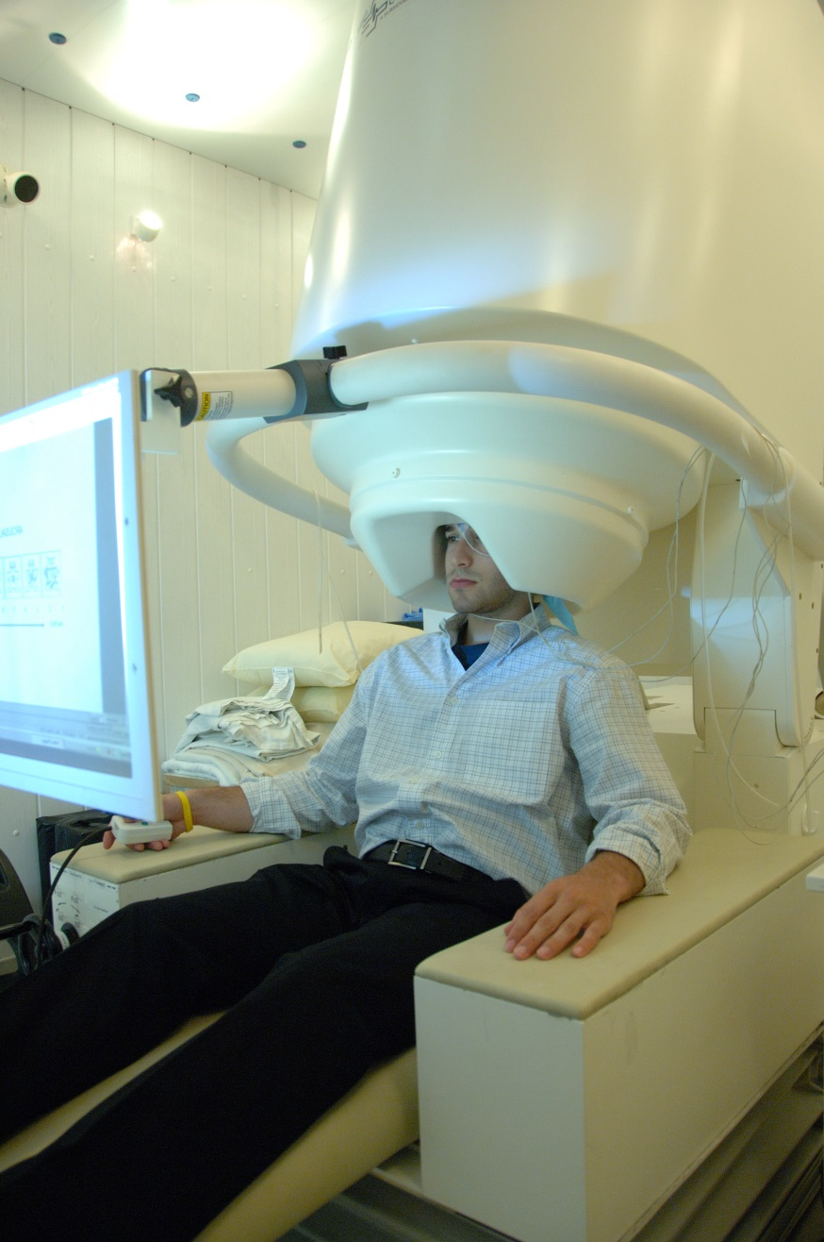
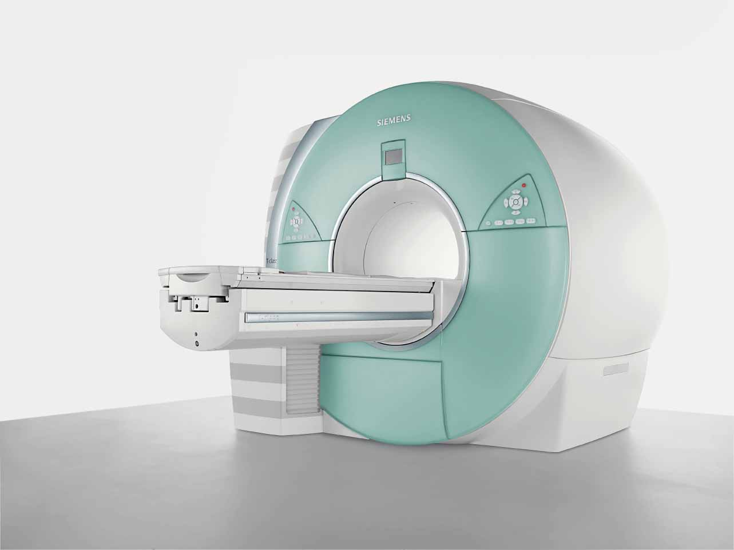
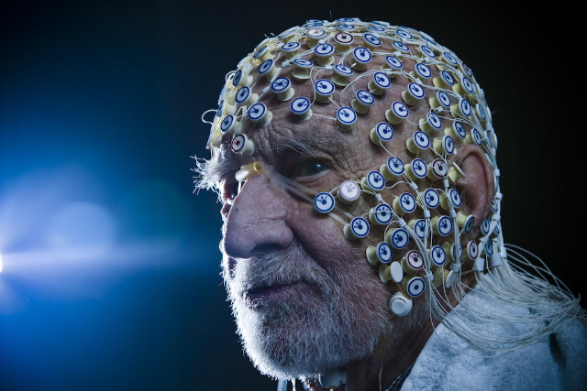
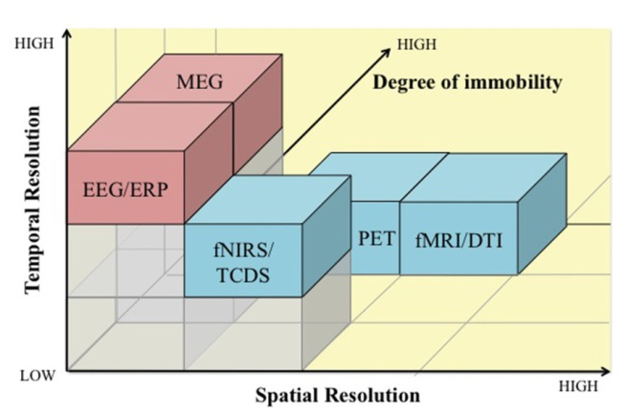
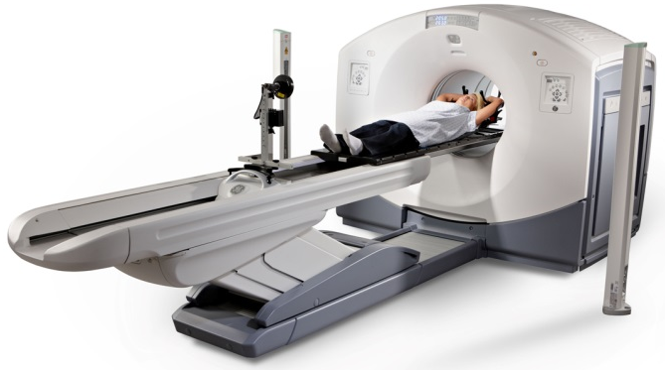
Neuroimaging Techniques
Mehta & Parasuraman (2013)
Notes:
EEG, electroencephalography; High temporal specificity, low spatial specificity, low immobility
Assesses electrical activity of the brain
ERP, event-related potentials; a measurement technique used in EEG
MEG, magnetoencephalography; High temporal specificty, low spatial specificity (better than EEG), high immobility
Assesses magnetic field generated by electrical activity of the brain
fNIRS, functional near infrared spectroscopy; Medium temporal specificity, medium spatial specificity, low immobility
Measures blood flow in the brain using near infra-red light
TCDS, transcranial Doppler sonography; Not discussed here
fMRI, functional magnetic resonance imaging; Low temporal specificity, high spatial specificity, high immobility
Measures blood flow in the brain through magnetic alignment of molecules
DTI, Diffusion tensor imaging; Analysis technique using fMRI
PET, positron emission tomography; Medium temporal specificity, med spatial specificity, high immobility
Requires injection of a mild radioactive tracer which emits positrons, this process also leads to gamma rays being produced, this is what the machine measures

Slide 34
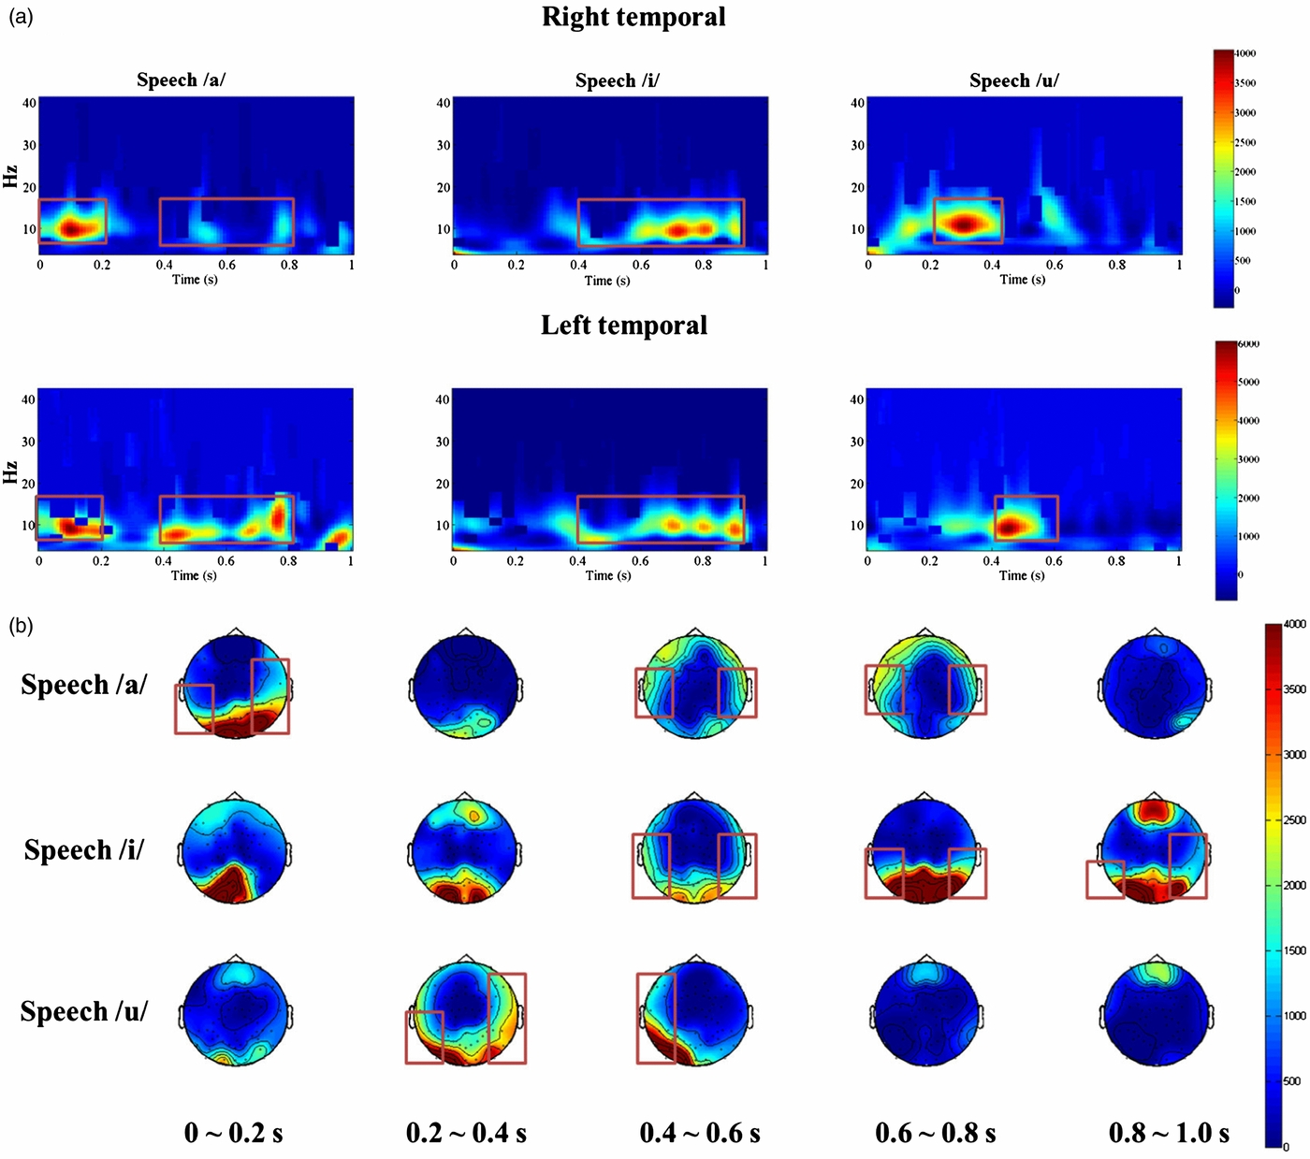
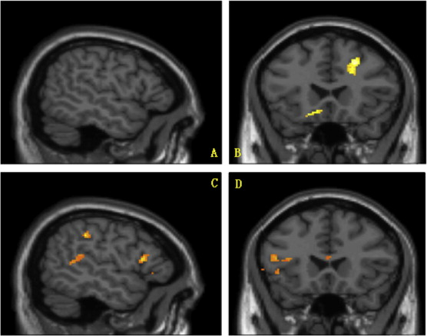
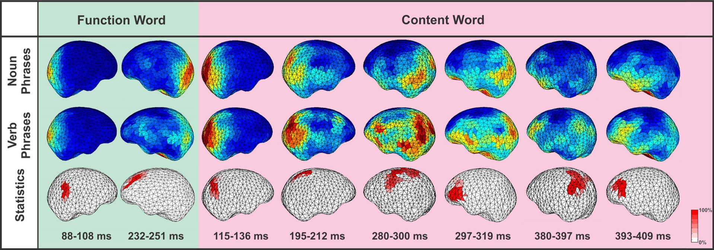
Neuroimaging Techniques
Tsiga, et al. (2014)
Friederici
(2012 )
Kim, et al. (2014)
Mehta & Parasuraman (2013)
Notes:
Various examples of the types of data produced by each measurement tool.

Slide 35
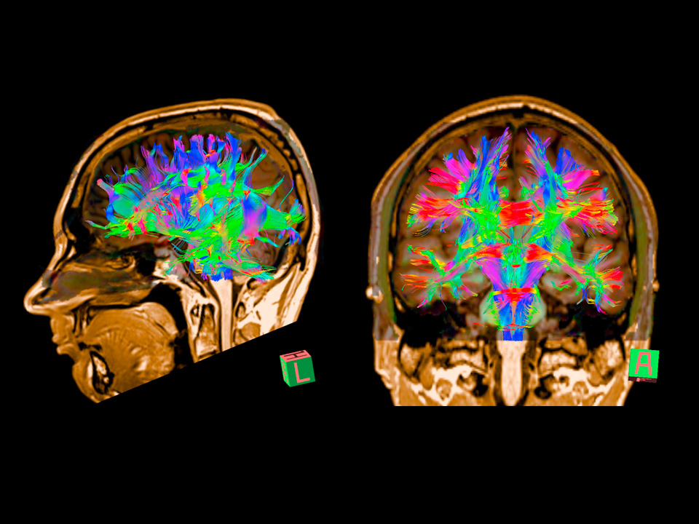
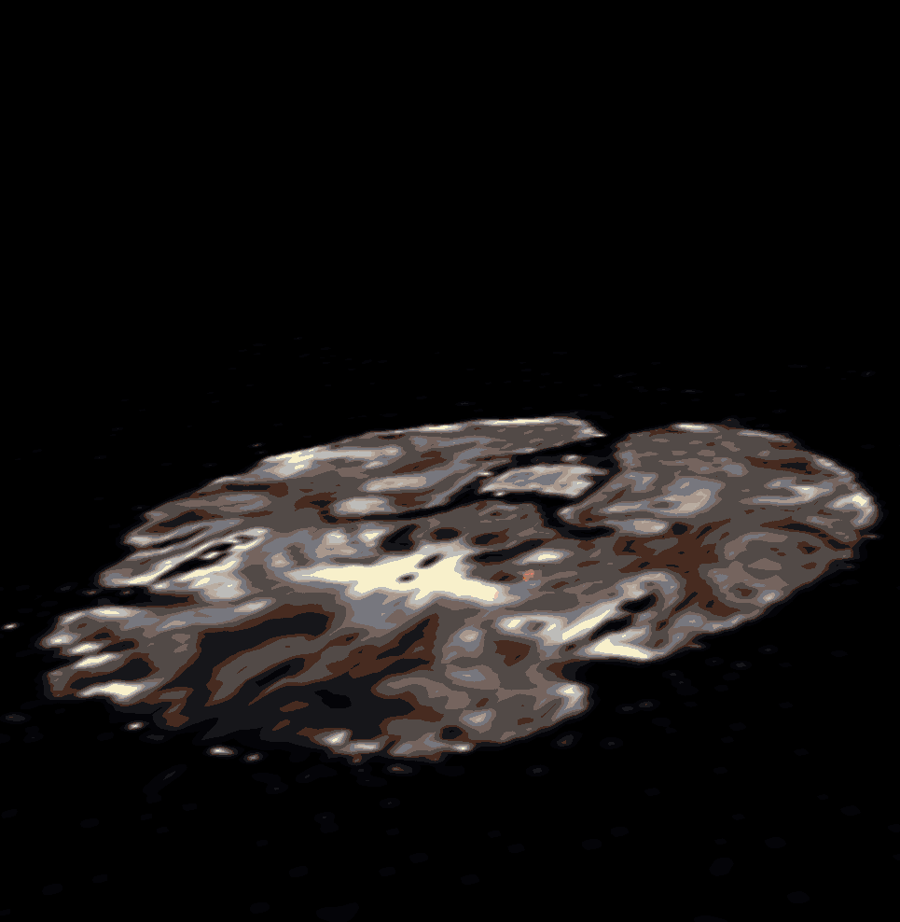
Diffusion Tensor Imaging / Tractography
Web Source [5]
Web Source [4]
Notes:
Just here to demonstrate the alternative things that can be done with MRI.
Also alludes to information later in the lecture regarding the integration problem.
DTI allows us to build up an image of the white matter tracts in a brain.
This, in turn, allows for inferences to be made about how different areas of the brain are connected.

Slide 36
Modern Advances

Slide 37
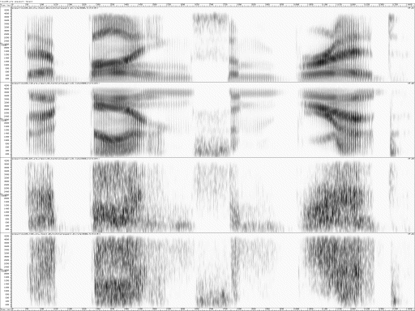

Classic neuroimaging evidence about language processing
Scott, et al. (2000)
Normal Speech
(Sp)
Spectrally Rotated Speech
(RSp)
Vocoded Speech
(VCo)
Rotated vocoded Speech
(RVCo)
http://www.phon.ucl.ac.uk/home/brain/
Notes:
Noise-vocoded speech is created by dividing the speech signal into logarithmically-spaced frequency bands. In each frequency band the amplitude envelope is extracted, and then used to modulate noise in the same frequency band. Finally each of the bands of noise are recombined to create the noise-vocoded sentence. Davis (2005)

Slide 38
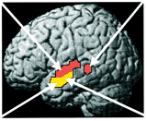
Classic neuroimaging evidence about language processing
Scott, et al. (2000)
Red = Responses to sounds with phonetic information
ie. Sp, RSp & VCo
Yellow = Responses to sounds that are intelligible
ie. Sp & VCo
http://www.phon.ucl.ac.uk/home/brain/
Notes:
Used PET to obtain data.
Demonstrates a different view to the WLG model as the temporal lobe is already separating input into un/intelligible categories even before reaching Wernicke’s area. This is a bit of an issue as comprehension was traditionally believed to occur in the supramaringal/angular gyrus.

Slide 39
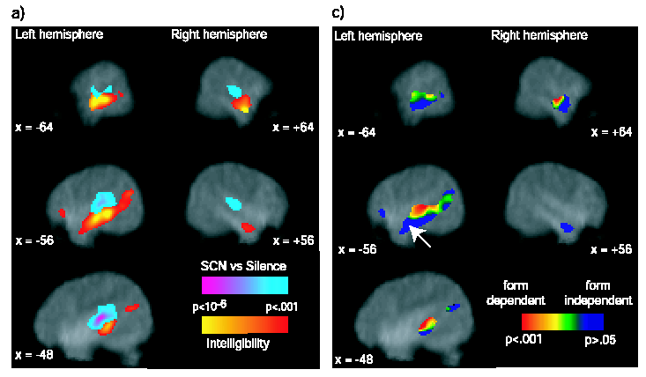
Classic neuroimaging evidence about language processing
Davis & Johnsrude
(2003)
English sentences, distorted in a variety of ways.
Looked for correlations between blood flow and intelligibility of speech sounds
Left: intelligible speech vs noise
Right: responses to different forms of distortion
Notes:
This is a good slide to introduce the notion of bottom-up and top-down processes.
Remember: top-down modulation need not be language specific
Davis and Johnsrude: more detailed study:
Speech in noise, Segmented, Vocoded
Left: These are the areas that light up when speech is intelligible as opposed to unintelligible
Right: These are the areas that light up according to the form of the distortion (acoustics)
What does this tell us?
Higher order areas are recruited to improve the signal to noise ratio of the incoming speech signal if the signal is distorted. This is shown by the recruitment of more areas in the form independent condition. Those sounds that are clearly speech, do not require further processing, they can be dealt with in areas local to the primary auditory cortex.
Additional information
This study also demonstrated the inclusion of the left anterior hippocampus (involved in memory formation), suggests large, interconnected networks.
However, this study also highlighted the dominant role of the left hemisphere in resolving perceptual ambiguity, finding only marginal activity in the right hemisphere.

Slide 40
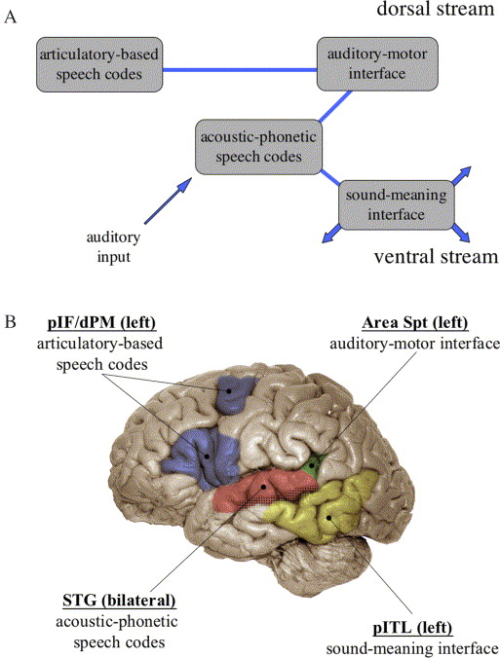
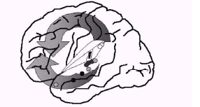
Classic neuroimaging evidence about language processing
Scott and Johnsrude (2003)
Hickock & Poeppel (2004)
Superior Temporal Gyrus
Bilateral (both hemispheres)
Acoustic-phonetic forms
Dorsal Stream (left only)
Wernicke’s area
Broca’s area
Motor cortex
Articulatory forms
Ventral Stream (left only)
Posterior Inferior Temporal Lobe
Sound-meaning interface
“Where/How”
“What”
Articulation (Wise et al. 2001)
Increasing numbers of channels of noise vocoded speech (Scott et al.)
Phonological (versus acoustic) change (Jacquemot et al.)
Speech and noise vocoded speech (vs. spectrally rotated equivalents)
(Scott et al. 2000)
Notes:
“This model integrates language processing networks into the broader scheme of cortical functional anatomy. It provides a context to interpret the neural basis not only of “traditional” language functions (broadly defined), such as speech perception, auditory comprehension, and speech production, but also provides a natural account of verbal working memory.” (pp. 94)
This view is often referred to as the 2-streams model, dorsal and ventral processing streams, which operate simultaneously

Slide 41
Lateralisation of language functions
Left Hemisphere
Right Hemisphere
Traditionally thought to be
Damage
may
spare production and
dominant for language processing
comprehension, but can lead to
problems with pragmatic ability,
Preference for
intelligible
speech
prosody, speaker characteristics
(
phonagnosia
), recognition of
music & environmental sounds
Possibly more sensitive to phonetic
Possibly more sensitive to speaker
form with
better time resolution
characteristics with better frequency
(limited
evidence
)
resolution (limited evidence)
Zatorre, et al. (2002); Scott, et al. (2009); Francis & Driscoll (2006);
Friederici (2011)
Left Hemisphere | Right Hemisphere
Traditionally thought to be dominant for language processing Preference for intelligible speech (Scott et al.) | Damage may spare production and comprehension, but can lead to problems with pragmatic ability, prosody, speaker characteristics (phonagnosia), recognition of music & environmental sounds
Possibly more sensitive to phonetic form with better time resolution (limited evidence) | Possibly more sensitive to speaker characteristics with better frequency resolution (limited evidence)
Notes:
Pinker (1994)
“normal people recognise words more accurately when the words are flashed to the right side of the visual field than when flashed to the left”
similar findings for ears

Slide 42
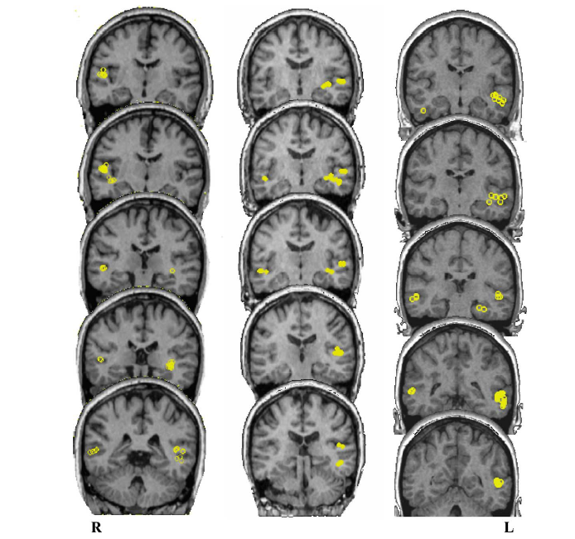
Chinese English Spanish
Lateralisation of language functions
Spoken word recognition test, which is used to establish cerebral dominance
Lateralisation (%Ss):
Spanish 100% left
English 80% left
Chinese 79% bilateral
(tone lang.)
Valaki et al. (2004)
Notes:
large groups of native speakers of Mandarin Chinese/English/Spanish
coronal MRI slices, data for 3 Ss, >200 ms post-stimulus onset

Slide 43
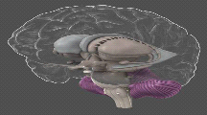
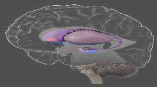
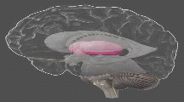
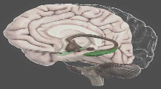
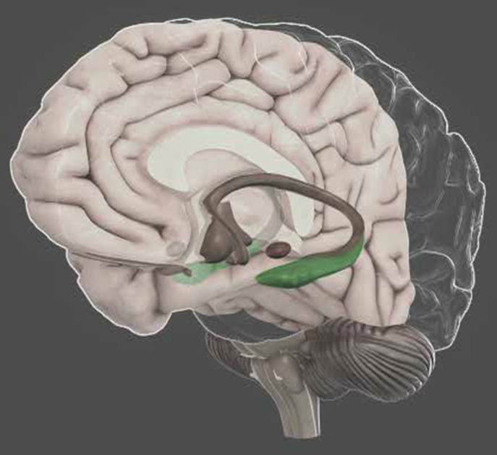
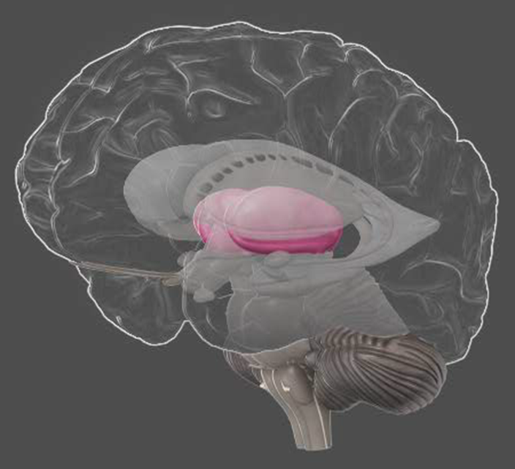
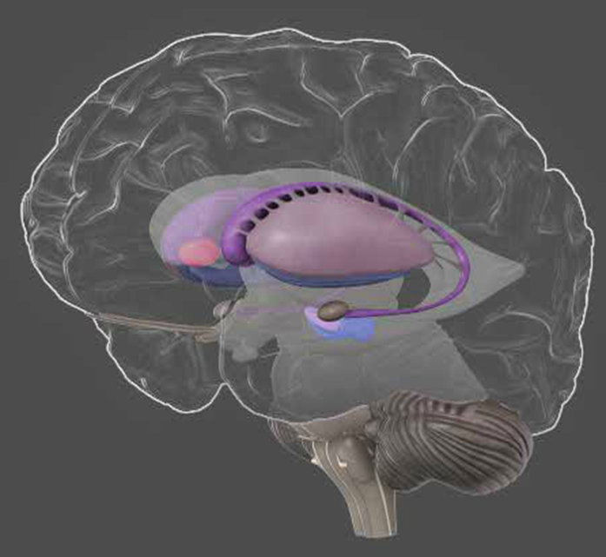
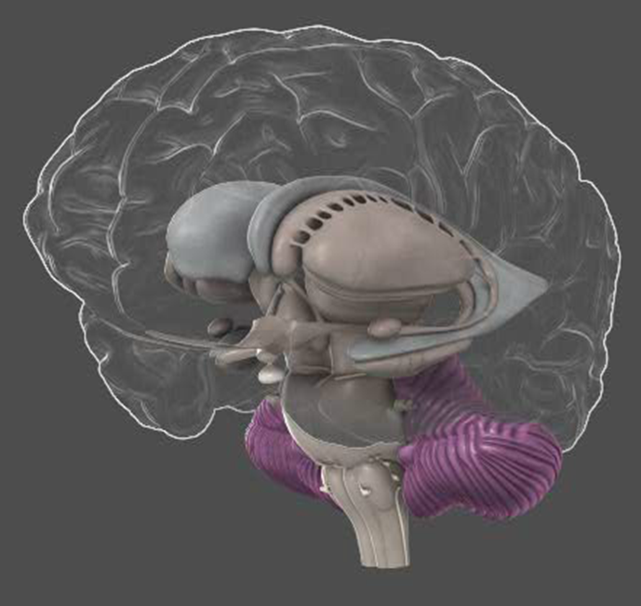
Language Processing Beyond the Cortex
Cerebellum
Basal Ganglia
Thalamus
Hippocampus
Co
-
ordinates muscle
Controls muscles of
Inner chamber
Long
-
term memory,
groups to produce
face, larynx, tongue
determines which
language
smooth
speech &
and pharynx
sensory information
comprehension,
swallowing.
Damage can lead to
to forward to cortex
word
-
generation
lack of coordination
Helps integrate
and facial
Damage can lead to
Damage (severe in
sensory perception
expression (e.g.
deficits in memory,
Alzheimer's) can
and motor output.
Parkinson’s)
attention, reduced
lead to word
-
finding
spontaneous speech
difficulties
Damage can lead to
Also disruption to
slurring of speech
rhythm and
temporal processing
Parkinson’s speech sample
courtesy of Dr Anja Lowit (Strathclyde)
Cerebellum | Basal Ganglia | Thalamus | Hippocampus
Co-ordinates muscle groups to produce smooth speech & swallowing. Helps integrate sensory perception and motor output. Damage can lead to slurring of speech | Controls muscles of face, larynx, tongue and pharynx Damage can lead to lack of coordination and facial expression (e.g. Parkinson’s) Also disruption to rhythm and temporal processing | Inner chamber determines which sensory information to forward to cortex Damage can lead to deficits in memory, attention, reduced spontaneous speech | Long-term memory, language comprehension, word-generation Damage (severe in Alzheimer's) can lead to word-finding difficulties

Slide 44
Neural correlates of phonetic skill
“Born with an ear for dialects?”
In naïve (English) listeners, an individual’s brain structure in left auditory cortex, parietal cortex, and left inferior frontal cortex partly predicts their ability to discriminate a difficult contrast (Hindi dental vs. retroflex) (Golestani et al., 2002, 2007)
In phoneticians, years of transcription experience correlate with size of left pars opercularis (Golestani et al., 2011)
Phoneticians are also more likely to have multiple or split left transverse gyri in auditory cortex (thought to develop in utero)
Notes:
Re final point: authors say “this gross morphological difference may have existed before the onset of phonetic training, and … its presence confers an advantage of sufficient magnitude to affect career choices” ☺

Slide 45

The Integration Problem
Behavioural data
(whole brain)
Localised neuro-functional data
(brain areas)
Localised anatomical data
(brain areas)
Connectivity data
(neuronal networks)
?
Notes:
From here on in the topics covered are still VERY experimental and incredibly hotly debated and should not be taken as read.

Slide 46

Phineas Gage and the Integration Problem
Van Horn, et al. (2012)
Notes:
By assessing the famous case of Phineas Gage Van Horn et al (2012) with Diffusion Weighted Imaging (DWI) and Magnetic Resonance Imaging (MRI) they were able to determine that only 4% of Mr. Gage’s grey matter was destroyed in comparison to 11% of his white matter. They conclude that although frontal lobe damage most certainly contributed to the functional deficits and personality changes that Mr. Gage suffered after his accident, the degree of white matter which was removed would have severely impacted on the manner in which his brain processed information. The role of white matter is just as important in understanding the mechanics of the human brain as the role of grey matter.

Slide 47
Friederici (2011) – Web Link, Firefox & Chrome Only
Notes:
This link demonstrates the white matter connections which are linked to linguistic functioning in the brain. They are fro more extensive than suggested by the WLG model and are somewhat more in keeping with the 2-streams model, with a dorsal and ventral processing route.

Slide 48
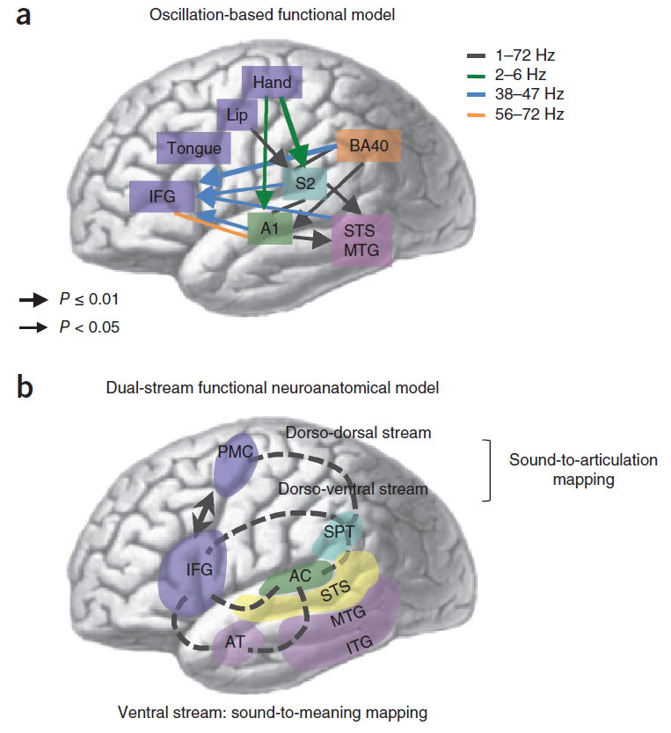

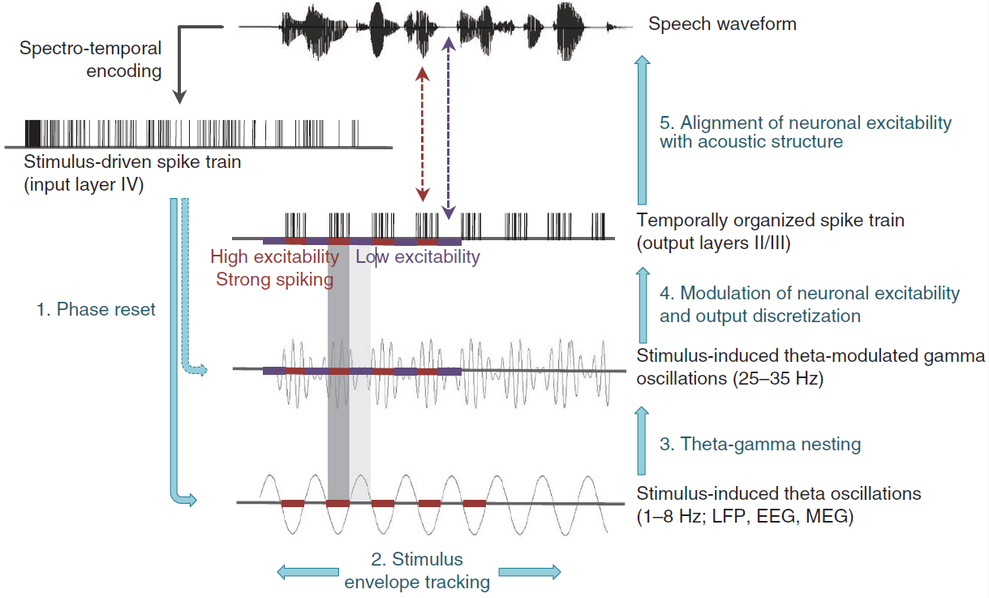
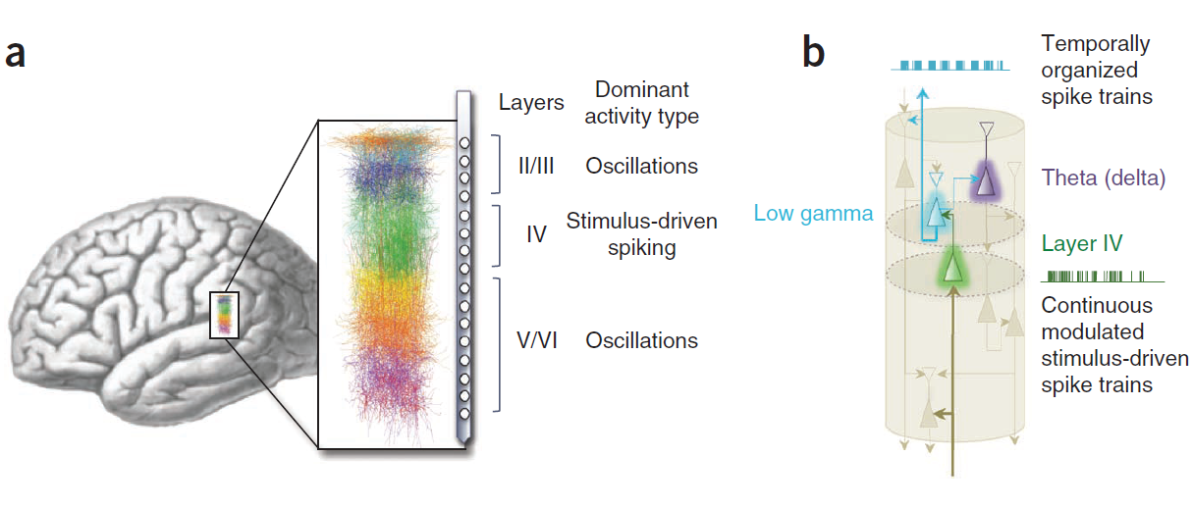
Neuronal Oscillations
Kim, et al. (2014)
Giraud & Poeppel (2012)
Notes:
Neuronal Oscillations
Giraud & Poeppel (2012)
In this article, we have articulated a set of hypotheses to investigate the relation between the perception of connected speech and neurobiological mechanisms. We developed a model at anatomic (Figs. 3 and 6), physiological (Figs. 1, 2 and 4) and computational (Fig. 5) levels. At the center of the research program lies the assumption that cortical oscillations provide ways to temporally organize the incoming speech signal. The main emerging principles are that two prerequisites for constructing intelligible representations of the speech stream are phase-locking between stimulus and cortex in (at least) two discrete time domains and the hierarchical coupling of related cortical oscillations during speech processing.
Critique
Oblesser, et al. (2012)
In sum, we argue that an overly enthusiastic focus on speech envelope and concomitantly a too narrow focus on theta oscillations, or the readiness to force all slower neural oscillations into a theta straightjacket, might not get us closer to the neural mechanics of speech comprehension. Without visionary, synergistic perspectives like the one offered by Giraud and Poeppel (2012) we will not make it there either.
Gross et al. (2013)
In summary, we report a nested hierarchy of auditory oscillations at multiple frequencies that match the frequency of
relevant linguistic components in continuous speech. These oscillations entrain to speech with differential hemispheric
preference for high (left) and low (right) frequencies. Our results indicate that temporal edges in speech increase first the coupling between auditory oscillations across frequency bands and, second, their coupling to the speech envelope.
We can only speculate about the nature of the observed phase/amplitude alignments. Most likely the alignments are caused by a combination of modulatory and evoked effects [55,56] where stimulus-driven activity is top-down modulated via ongoing oscillatory activity [30,61]. In this framework oscillatory activity is a mechanism for attentional selection and flexible gating of information from primary sensory areas.
Finally, going beyond speech perception, the entrainment of hierarchically organized oscillations between speaker and
listener may well have a more general role in interpersonal communication [62,63].

Slide 49
Neuronal Coherence
Adapted from Fries (2005)
Also see: Bastos, et al. (2015); Brunet, et al. (2015)
Notes:
Animations on this slide demonstrate how oscillatory behaviour can be modelled in terms of individual communicating neurons. It also demonstrates how information can be separated into redundant and useful. This could potentially help to explain exactly how the brain determines which information can be directly interpreted in the primary auditory cortex and close areas from information which requires further processing in higher areas.

Slide 50
Conclusion?
“it takes the whole brain and, by extension, the whole person to participate in producing and perceiving a voice”
Sidtis & Kreiman (2011)
Notes:
A lot of work still needs to be done, there are no clear cut answers at the moment, the best I can offer is this quote from Kreiman & Sidtis (2012)

Slide 51
References
Andoh, J., Artiges, E., Pallier, C., Riviиre, D., Mangin, J.-F., Paillиre-Martinot, M.-L. & Martinot, J.-L. (2008). Priming frequencies of transcranial magnetic stimulation over Wernicke's area modulate word detection.. Cerebral cortex (New York, N.Y. : 1991) 18 (1), 210--6. (Doi: 10.1093/cercor/bhm047.) Retrieved from http://cercor.oxfordjournals.org/content/18/1/210.full.
Anwander, A., Tittgemeyer, M., von Cramon, D. Y., Friederici, A. D. & Knцsche, T. R. (2007). Connectivity-Based Parcellation of Broca's Area.. Cerebral cortex (New York, N.Y. : 1991) 17 (4), 816--25. (Doi: 10.1093/cercor/bhk034.) Retrieved from http://cercor.oxfordjournals.org/content/17/4/816.full.
Bastos, A. M., Vezoli, J. & Fries, P. (2015). Communication through coherence with inter-areal delays. Current Opinion in Neurobiology 31, 173--180. (Doi: 10.1016/j.conb.2014.11.001.) Retrieved from http://www.sciencedirect.com/science/article/pii/S0959438814002165.
Brunet, N., Vinck, M., Bosman, C. A., Singer, W. & Fries, P. (2014). Gamma or no gamma, that is the question. Trends in Cognitive Sciences 18 (10), 507--509. (Doi: 10.1016/j.tics.2014.08.006.) Retrieved from http://www.sciencedirect.com/science/article/pii/S1364661314002009.
Davis, M. H. & Johnsrude, I. S. (2003). Hierarchical Processing in Spoken Language Comprehension. J. Neurosci. 23 (8), 3423--3431. Retrieved from http://www.jneurosci.org/content/23/8/3423.short.
Feng, S., Legault, J., Yang, L., Zhu, J., Shao, K. & Yang, Y. (2015). Differences in grammatical processing strategies for active and passive sentences: An fMRI study. Journal of Neurolinguistics 33 (0), 104--117. (Doi: http://dx.doi.org/10.1016/j.jneuroling.2014.09.002.) Retrieved from http://www.sciencedirect.com/science/article/pii/S0911604414000591.

Slide 52
References
Francis, A. L. & Driscoll, C. (2006). Training to use voice onset time as a cue to talker identification induces a left-ear/right-hemisphere processing advantage.. Brain and language 98 (3), 310--8. (Doi: 10.1016/j.bandl.2006.06.002.) Retrieved from http://www.sciencedirect.com/science/article/pii/S0093934X06001131.
Friederici, A. D. (2012). The cortical language circuit: from auditory perception to sentence comprehension. Trends in Cognitive Sciences 16 (5), 262--268. (Doi: http://dx.doi.org/10.1016/j.tics.2012.04.001.) Retrieved from http://www.sciencedirect.com/science/article/pii/S1364661312000794.
Friederici, A. D. (2011). The brain basis of language processing: from structure to function.. Physiological reviews 91 (4), 1357--92. (Doi: 10.1152/physrev.00006.2011.) Retrieved from http://physrev.physiology.org/content/91/4/1357.full-text.pdf+html.
Fries, P. & Others (2005). A mechanism for cognitive dynamics: neuronal communication through neuronal coherence. Trends in cognitive sciences 9 (10), 474--480.
Ghitza, O., Giraud, A.-L. & Poeppel, D. (2012). Neuronal oscillations and speech perception: critical-band temporal envelopes are the essence.. Frontiers in human neuroscience 6 (340), 340. (Doi: 10.3389/fnhum.2012.00340.) Retrieved from http://www.pubmedcentral.nih.gov/articlerender.fcgi?artid=3539830&tool=pmcentrez&rendertype=abstract http://www.frontiersin.org/human_neuroscience/10.3389/fnhum.2012.00340/abstract.
Giraud, A.-L. & Poeppel, D. (2012). Cortical oscillations and speech processing: emerging computational principles and operations.. Nature neuroscience 15 (4), 511--7. (Doi: 10.1038/nn.3063.) Retrieved from http://www.ncbi.nlm.nih.gov/pubmed/22426255.

Slide 53
References
Golestani, N., Molko, N., Dehaene, S., LeBihan, D. & Pallier, C. (2007). Brain structure predicts the learning of foreign speech sounds.. Cerebral cortex (New York, N.Y. : 1991) 17 (3), 575--82. (Doi: 10.1093/cercor/bhk001.) Retrieved from http://cercor.oxfordjournals.org/content/17/3/575.full.
Golestani, N., Paus, T. & Zatorre, R. J. (2002). Anatomical Correlates of Learning Novel Speech Sounds. Neuron 35 (5), 997--1010. (Doi: 10.1016/S0896-6273(02)00862-0.) Retrieved from http://www.sciencedirect.com/science/article/pii/S0896627302008620.
Golestani, N., Price, C. J. & Scott, S. K. (2011). Born with an ear for dialects? Structural plasticity in the expert phonetician brain.. The Journal of neuroscience : the official journal of the Society for Neuroscience 31 (11), 4213--20. (Doi: 10.1523/JNEUROSCI.3891-10.2011.) Retrieved from http://www.jneurosci.org/content/31/11/4213.full.
Gross, J., Hoogenboom, N., Thut, G., Schyns, Philippe Phillippe, Panzeri, S., Belin, P., Garrod, S. & Stefano, P. (2013). Speech rhythms and multiplexed oscillatory sensory coding in the human brain.. PLoS biology 11 (12), e1001752. (Doi: 10.1371/journal.pbio.1001752.) Retrieved from http://www.pubmedcentral.nih.gov/articlerender.fcgi?artid=3876971&tool=pmcentrez&rendertype=abstract.
Hagoort, P. (2014). Nodes and networks in the neural architecture for language: Broca's region and beyond.. Current opinion in neurobiology 28C, 136--141. (Doi: 10.1016/j.conb.2014.07.013.) Retrieved from http://www.sciencedirect.com/science/article/pii/S095943881400141X.
Hertrich, I. & Ackermann, H. (2013). Neurophonetics. Wiley Interdisciplinary Reviews: Cognitive Science 4 (2), 191--200. (Doi: 10.1002/wcs.1211.) Retrieved from http://doi.wiley.com/10.1002/wcs.1211.
Hervé, P.-Y., Zago, L., Petit, L., Mazoyer, B. & Tzourio-Mazoyer, N. (2013). Revisiting human hemispheric specialization with neuroimaging.. Trends in cognitive sciences 17 (2), 69--80. (Doi: 10.1016/j.tics.2012.12.004.) Retrieved from http://www.sciencedirect.com/science/article/pii/S1364661312002847.

Slide 54
References
Hickok, G. & Poeppel, D. (2004). Dorsal and ventral streams: a framework for understanding aspects of the functional anatomy of language.. Cognition 92 (1-2), 67--99. (Doi: 10.1016/j.cognition.2003.10.011.) Retrieved from http://www.sciencedirect.com/science/article/pii/S0010027703002282.
Jolles, D., Wassermann, D., Chokhani, R., Richardson, J., Tenison, C., Bammer, R., Fuchs, L., Supekar, K. & Menon, V. (2015). Plasticity of left perisylvian white-matter tracts is associated with individual differences in math learning. Brain Structure and Function, 1--15. (Doi: 10.1007/s00429-014-0975-6.) Retrieved from http://dx.doi.org/10.1007/s00429-014-0975-6.
Kim, J., Lee, S.-K. & Lee, B. (2014). EEG classification in a single-trial basis for vowel speech perception using multivariate empirical mode decomposition. Journal of Neural Engineering 11 (3), 36010--36021. (Doi: doi:10.1088/1741-2560/11/3/036010.) Retrieved from http://www.ingentaconnect.com/content/iop/jne/2014/00000011/00000003/art036010.
Mehta, R. K. & Parasuraman, R. (2013). Neuroergonomics: A Review of Applications to Physical and Cognitive Work. Frontiers in Human Neuroscience 7 (889). (Doi: 10.3389/fnhum.2013.00889.) Retrieved from http://www.frontiersin.org/human_neuroscience/10.3389/fnhum.2013.00889/abstract.
Nielsen, J. A., Zielinski, B. A., Ferguson, M. A., Lainhart, J. E. & Anderson, J. S. (2013). An evaluation of the left-brain vs. right-brain hypothesis with resting state functional connectivity magnetic resonance imaging.. PloS one 8 (8), e71275. (Doi: 10.1371/journal.pone.0071275.) Retrieved from http://journals.plos.org/plosone/article?id=10.1371/journal.pone.0071275.
Obleser, J., Herrmann, B. & Henry, M. J. (2012). Neural oscillations in speech: don't be enslaved by the envelope. Frontiers in Human Neuroscience 6.

Slide 55
References
Scott, S. K. (2000). Identification of a pathway for intelligible speech in the left temporal lobe. Brain 123 (12), 2400--2406. (Doi: 10.1093/brain/123.12.2400.) Retrieved from http://brain.oxfordjournals.org/content/123/12/2400.
Scott, S. K., McGettigan, C. & Eisner, F. (2009). A little more conversation, a little less action–candidate roles for the motor cortex in speech perception.. Nature reviews. Neuroscience 10 (4), 295--302. (Doi: 10.1038/nrn2603.) Retrieved from http://dx.doi.org/10.1038/nrn2603.
Sidtis, D. & Kreiman, J. (2012). In the beginning was the familiar voice: personally familiar voices in the evolutionary and contemporary biology of communication. Integrative psychological & behavioral science 46 (2), 146--59. (Doi: 10.1007/s12124-011-9177-4.) Retrieved from http://www.pubmedcentral.nih.gov/articlerender.fcgi?artid=3224673&tool=pmcentrez&rendertype=abstract.
Tsigka, S., Papadelis, C., Braun, C. & Miceli, G. (2014). Distinguishable neural correlates of verbs and nouns: A MEG study on homonyms. Neuropsychologia 54 (0), 87--97. (Doi: http://dx.doi.org/10.1016/j.neuropsychologia.2013.12.018.) Retrieved from http://www.sciencedirect.com/science/article/pii/S002839321300448X.
Valaki, C. E., Maestu, F., Simos, P. G., Zhang, W., Fernandez, A., Amo, C. M., Ortiz, T. M. & Papanicolaou, A. C. (2004). Cortical organization for receptive language functions in Chinese, English, and Spanish: a cross-linguistic MEG study. Neuropsychologia 42 (7), 967--79. (Doi: 10.1016/j.neuropsychologia.2003.11.019.) Retrieved from http://www.sciencedirect.com/science/article/pii/S0028393203003269.
Van Horn, J. D., Irimia, A., Torgerson, C. M., Chambers, M. C., Kikinis, R. & Toga, A. W. (2012). Mapping Connectivity Damage in the Case of Phineas Gage. PLoS ONE 7 (5), e37454. (Doi: 10.1371/journal.pone.0037454.) Retrieved from http://dx.doi.org/10.1371%2Fjournal.pone.0037454.
Zatorre, R. J., Belin, P. & Penhune, V. B. (2002). Structure and function of auditory cortex: music and speech. Trends in cognitive sciences 6 (1), 37--46. Retrieved from http://www.ncbi.nlm.nih.gov/pubmed/11849614.
Ziegler, W. (2009). Neurophonetics. In The Handbook of Clinical Linguistics (pp. 491--505). Blackwell Publishing Ltd. (ISBN: 9781444301007.) Retrieved from http://dx.doi.org/10.1002/9781444301007.ch31.

Slide 56
References
Web Sources
[1] - http://www.rijnlandmodel.nl/achtergrond/psychologie/neurologie_neuronen_algemeen.htm
[2] - http://thebrain.mcgill.ca/flash/d/d_02/d_02_cl/d_02_cl_vis/d_02_cl_vis.html
[3] - http://neuropathology-web.org/chapter2/chapter2bCerebralinfarcts.html
[4] - http://www.kgu.de/bic/common.htm
[5] - http://cfmm.robarts.ca/tools/3t-mri/

Slide 57
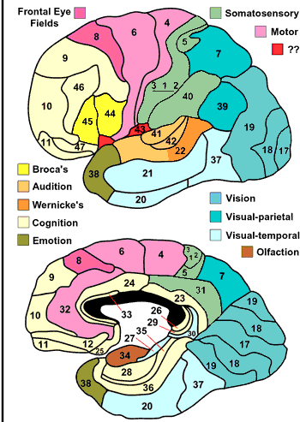
Brodmann’s
areas
Notes:
Useful to refer to Brodmann’s areas – classification system developed in early 20th century to identify areas.
Broca’s area – 44 and 45
Wernicke’s area – 22
Others important for speech/language:
41 and 42 = Primary Auditory cortex (on lateral fissure)
37 = occipital temporal – shown to be involved in processing of written words or letter strings (affected in dyslexia)

Slide 58
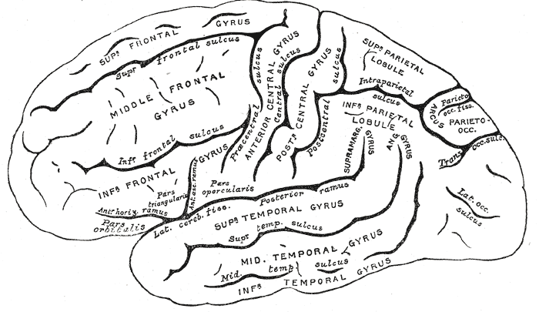

Slide 59
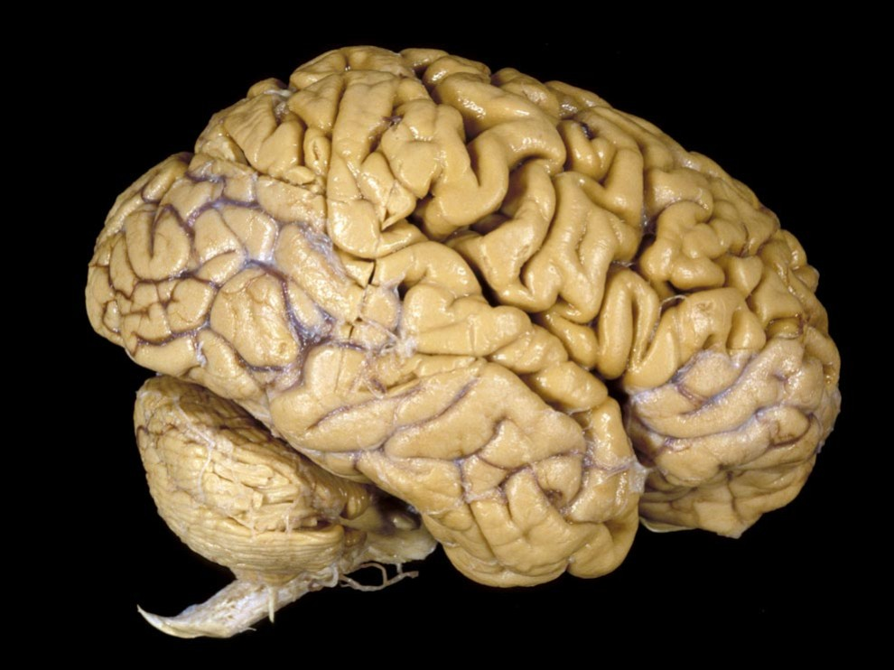
Photograph by Fred Hossler
Notes:
Crumpled/lumpy
3-4 months of development, surface of brain FOLDS up.
Lot of tissue squeezed into small area
Brain surgery
Skull sawn to remove top (cranium)
Brain is mobile within skull but keeps shape due to skull

Slide 60
A Quick Orientation

Slide 61
Arcuate Fasciculus
Connection between Broca’s and Wernicke’s
Conduction Aphasia
good comprehension, good spontaneous speech
poor repetition, poor response
Notes:
Arcuate Fasciculus:
the connection between BRocas and Wernickes where –
speech is fluent, comprehension remains good, oral reading is poor, repetition is poor
transpositions of sounds within a word ("television" → "velitision") are common.
In contrast, when brocas and wernickes are in tact but not connected to rest of cortex – repetitions can be made but with no understanding and no spontaneous speech

Slide 62
Wernicke’s Aphasia
Her normal corrucation would be a dot
Well this is .... mother is away here working her work out o'here to get her better, but when she's looking, the two boys looking in other part. One their small tile into her time here. She's working another time because she's getting, too. So two boys work together and one is sneakin' around here, making his work an' his further funnas his time he had.
Notes:
Brodmann 22 (39 and 40) also, 39 =semantics, 40 = memory

Slide 63
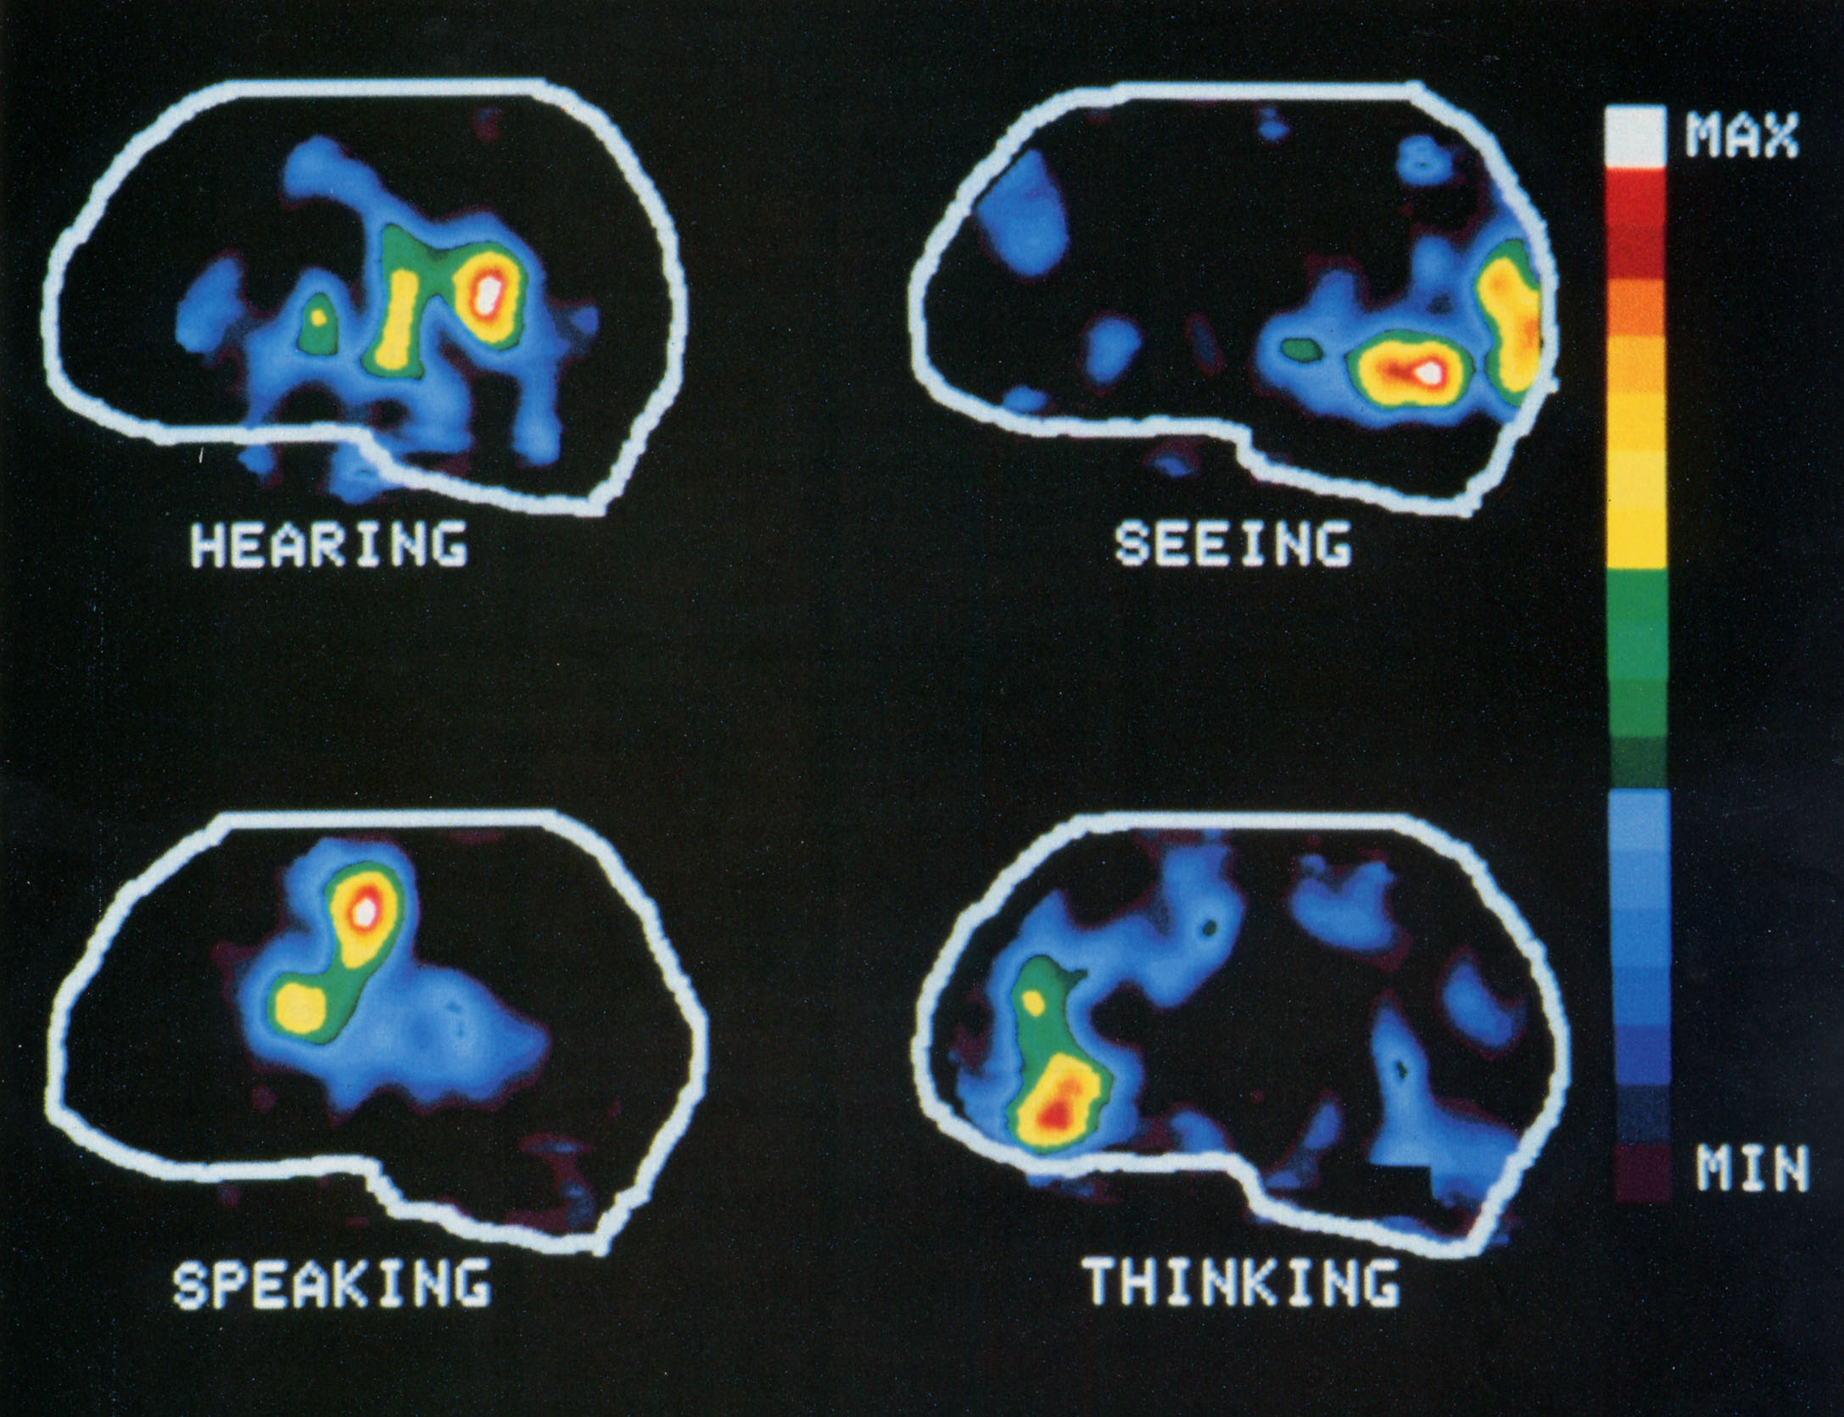
PET (positron emission tomography) scan
Notes:
Big areas involved in all four.
A surprising (maybe) amount of overlap.
This is compared to resting. And there will be overlap. Of course, when we speak, we also hear ourselves. (Etc.)
A big challenge was to decide WHAT TO COMPARE WITH WHAT – the choice of BASELINES.

Slide 64

Neural pathways for intelligible speech
Scott et al (2000)
spectrally rotated speech
http://www.phon.ucl.ac.uk/home/brain/

Slide 65
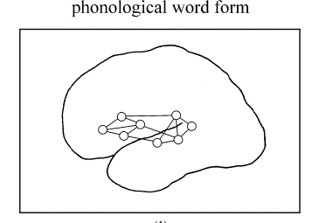
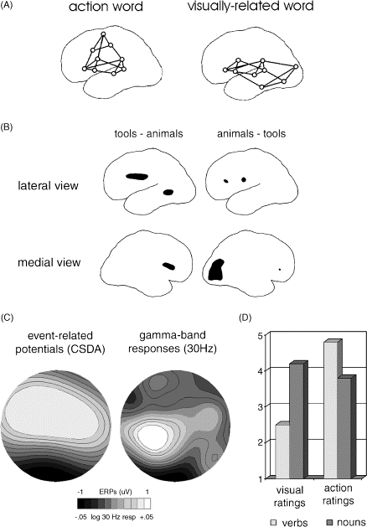

Functional webs for words Pulvermuller, 1999 Behavioral and Brain Sciences; 2003 book The Neuroscience of Language
Cell assemblies connect all neurons involved in the processes triggered by an object or action
These assemblies “are” the cortical representation of this object or action
Notes:
Short-term memory: activation and “reverberation” of the assembly
Long-term memory: changes in patterns of connectivity among the cells in the assembly

Slide 66
Action vs. vision words
Top: schematic predictions
Bottom: fMRI data
Left panels: a pre-motor area and a middle temporal area are more strongly excited by words for tools than words for animals
Right panels: an occipital area is more strongly excited by words for animals than words for tools
Source: Pulvermuller (2002), Progress in Neurobiology 67
Notes:
Remember: occipital is vision part

Slide 67

Face vs arm vs leg words
Left: Structure of somatotopic maps in motor cortex
fMRI (one subject’s data):
Black areas: stronger activation for foot-related verbs eg kick
White areas: stronger activation for hand-related verbs eg pick
Source: Pulvermuller (2002)
Notes:
Called somatotopic – soma is body as in “psychosomatic” -- means maps/representations of the body

Slide 68
Distributed, multimodal memory networks for words
Hebbian learning (Hebb 1949): “cells that fire together, wire together”
→ synchronously activated neurons link into cell assemblies: functional webs/networks

Slide 69
Hemispheric differences: form
RH has been argued to analyse sounds with better frequency resolution and poorer time resolution than LH (Zatorre, Belin, & Penhune, 2002), but evidence is limited (Scott, McGettigan & Eisner, 2009)

Slide 70
Hemispheric differences: function
“Same” property may be processed dominantly by one or other hemisphere, according to function
e.g. VOT as a cue to
segment identity (/pa/ vs /ba/) – LH
speaker identity – RH
(Francis & Driscoll, 2006)

